Slide 1

Introduction to Data Mining and CRISP-DM Framework
Week 1
Semester 1, 2025
Dr. Farshid Keivanian

Slide 2
Unit Learning Outcomes
LO1 Explain various computational and statistical techniques for data mining and their applications (GA5, GA8)
LO2 discuss ethical perspectives in data mining such as subsidiarity, stewardship of resources, and human dignity (GA3, GA5)
LO3 Apply data mining tools and techniques to generate human- interpretable patterns that describe the data (GA5, GA10)
LO4 Develop and evaluate predictive data mining models (GA10, GA5)

Slide 3
Assessment Overview
Brief Description of Kind and Purpose of Assessment Tasks | Explanation | Weighting | Learning Outcome/s Assessed | Graduate Attributes/ Generic Skills
Assessment Task 1: Developmental Exercises (Individual) Artefact: Program files | This assessment consists of a series of weekly exercises, including data cleaning/transformation, exploratory data analysis, cluster analysis and predictive model building using a data mining tool (e.g. RapidMiner). | 25% | LO1, LO2, LO3 | GA5, GA10

Slide 4
Brief Description of Kind and Purpose of Assessment Tasks | Explanation | Weighting | Learning Outcome/s Assessed | Graduate Attributes/ Generic Skills
Assessment Task 2: Exploratory Data Mining Project (Individual) Artefact: Written report + Program file + presentation | The primary purpose of this assessment is to provide students with an opportunity to develop data mining skills for finding human-interpretable patterns that describe the data analysis skills. In this assignment, student will perform data cleaning/transformation, exploratory data analysis and cluster analysis on a dataset, using a data mining tool (RapidMiner). In this task students will also apply the ethical principles of data mining in the context of the case study. | 30% | LO1, LO2, LO3 | GA5, GA10

Slide 5
Brief Description of Kind and Purpose of Assessment Tasks | Explanation | Weighting | Learning Outcome/s Assessed | Graduate Attributes/ Generic Skills
Assessment Task 3: Predictive Data Mining Project Artefact: Written report + Program file + presentation | The primary purpose of this assessment is to provide students with an opportunity to develop data predictive data mining skills. In this assignment, student will build and evaluate predictive models, detect anomaly and find association between variables in the given datasets using a data mining tool (RapidMiner). In this task students will also apply the ethical principles of data mining in the context of the case study. | 45% | LO1, LO2, LO3, LO4 | GA3, GA5, GA8, GA10

Slide 6

What are we doing this week?
Understanding the fundamentals of Data Mining
Exploring the Data Mining process and CRISP-DM framework
Identifying various types and sources of data
Overview of Data Mining Tools (Python, RapidMiner, WEKA, Tableau, etc.)
Introduction to RapidMiner and its applications

Slide 7
What is Data mining?
Data Mining is the process of discovering patterns, relationships, and insights from large datasets using statistical, machine learning, and computational techniques. It is widely used in various industries such as healthcare, finance, marketing, and cybersecurity to make data-driven decisions.

Slide 8
Key Aspects of Data Mining
Extracting knowledge from structured and unstructured data.
Identifying hidden patterns in large datasets.
Predicting outcomes using machine learning models.
Enhancing decision-making through data-driven insights.

Slide 9
Discussion Question
Why is Data Mining important in today’s digital world?
Data Mining is crucial in today’s digital world as it helps uncover hidden patterns, trends, and relationships within massive datasets, enabling businesses, governments, and researchers to make informed decisions. It supports areas such as fraud detection, healthcare diagnostics, personalized marketing, and predictive analytics.

Slide 10
Discussion Question
Example of Data Mining in Real Life
Australia: The Australian Taxation Office (ATO) uses Data Mining to detect tax fraud and anomalies by analyzing transaction patterns and identifying unusual activities.
Global: Netflix & Spotify use Data Mining for personalized recommendations, analyzing user behavior to suggest relevant movies, shows, or songs.

Slide 11
Discussion Question
How does Data Mining differ from traditional data analysis?
Traditional Data Analysis focuses on descriptive insights (summarizing data, trends, and patterns using statistics).
Data Mining goes further by using machine learning and AI techniques to discover patterns, make predictions, and automate decision-making.

Slide 12
Data Mining Process
The Data Mining Process is a structured approach that guides the extraction of meaningful insights from large datasets. It typically follows the CRISP-DM (Cross-Industry Standard Process for Data Mining) framework, which consists of six key phases:

Slide 13
Data Mining Process
1. Business Understanding
Define the project goals and how data mining can address them.
Identify business problems that can be solved using data insights.
Example: A bank wants to predict which customers are likely to default on loans.

Slide 14
Data Mining Process
2. Data Understanding
Collect and explore the data.
Identify missing values, outliers, and patterns.
Perform Exploratory Data Analysis (EDA) using summary statistics and visualizations.
Example: An Australian retail company analyzes customer transactions to understand purchasing behavior.

Slide 15
Data Mining Process
3. Data Preparation
Clean the dataset (handle missing values, remove duplicates, and correct inconsistencies).
Transform data (normalization, encoding categorical variables).
Feature selection and engineering to enhance model performance.
Example: A telecommunications company preprocesses call logs before applying a churn prediction model.

Slide 16
Data Mining Process
4. Modeling
Apply machine learning or statistical techniques to find patterns.
Train and evaluate different models such as classification, clustering, regression, or association rule mining.
Example: A health organization in Australia uses Random Forest models to predict patient readmission rates.

Slide 17
Data Mining Process
5. Evaluation
Assess the model’s accuracy, precision, recall, F1-score, and overall effectiveness.
Compare different models and refine them based on results.
Example: A financial institution compares Logistic Regression vs. Neural Networks for fraud detection.

Slide 18
Data Mining Process
6. Deployment
Implement the model in a real-world environment for decision-making.
Monitor performance and update models as needed.
Example: A global e-commerce platform deploys a recommendation system for personalized product suggestions.

Slide 19
Data Mining Process
How is Data Mining Used in Australia and Globally?
In Australia:
The Australian Taxation Office (ATO) uses data mining to detect tax fraud and anomalies.
Australian banks apply machine learning models to predict loan defaults and prevent financial fraud.
Healthcare organizations leverage predictive models to forecast hospital resource needs.

Slide 20
Data Mining Process
Globally:
Amazon & Netflix use data mining for personalized recommendations.
Google & Facebook analyze user behavior to optimize advertising.
The World Health Organization (WHO) applies data mining to track disease outbreaks and vaccination trends.

Slide 21
Problem-Solving Questions & Answers
Question 1: Business Understanding
Scenario: A supermarket chain in Australia wants to improve its customer loyalty program. The company has transaction data from thousands of customers but doesn't know how to use it effectively.
Problem: How can data mining help the supermarket understand customer purchasing behavior and increase loyalty?

Slide 22
Problem-Solving Questions & Answers
Answer:
Apply association rule mining (e.g., Apriori Algorithm) to find frequently bought item combinations (e.g., "Milk & Bread").
Use clustering (e.g., K-Means) to segment customers based on spending patterns.
Develop predictive models to forecast which customers are likely to stop shopping at the store.
Personalize marketing campaigns using insights from data mining.

Slide 23
Problem-Solving Questions & Answers
Question 2: Data Understanding
Scenario: A telecom company in Australia is analyzing customer complaints and call drop records. The dataset has columns for "Call Duration," "Network Coverage," "Customer Satisfaction Score," and "Complaint Type."
Problem: What EDA techniques should be applied before building a predictive model for customer churn?

Slide 24
Problem-Solving Questions & Answers
Answer:
Summary Statistics: Compute mean, median, and mode for numerical variables.
Data Visualization: Use histograms and boxplots to check distributions of call durations and network coverage.
Correlation Analysis: Identify relationships between customer satisfaction scores and call drop frequency.
Missing Data Handling: Use imputation techniques for incomplete records.
Outlier Detection: Identify unusually low call durations or extreme customer satisfaction scores.

Slide 25
Problem-Solving Questions & Answers
Question 3: Data Preparation
Scenario: A healthcare provider is using patient data to predict the risk of developing heart disease. The dataset contains missing values for BMI and cholesterol levels.
Problem: How should missing data be handled before building a predictive model?

Slide 26
Problem-Solving Questions & Answers
Answer:
Remove missing values if the percentage of missing data is low.
Impute missing values using:
Mean/Median imputation (for numerical data).
Mode imputation (for categorical data).
Predictive imputation (use regression models to estimate missing values).
Use feature engineering to create new variables that help replace missing values.

Slide 27
Problem-Solving Questions & Answers
Question 4: Modeling
Scenario: A bank wants to predict which customers are likely to default on loans. They decide to use Logistic Regression and Random Forest models.
Problem: What factors should be considered when selecting the best model?

Slide 28
Problem-Solving Questions & Answers
Answer:
Accuracy & Precision: Compare how well each model classifies defaulters.
ROC-AUC Score: Higher scores indicate better separation between defaulters and non-defaulters.
Feature Importance: Random Forest provides insights into key factors influencing default risk.
Computational Efficiency: Logistic Regression is faster and interpretable, whereas Random Forest is more powerful for complex patterns.
Overfitting: Random Forest might overfit if not tuned properly; use cross-validation.

Slide 29
Problem-Solving Questions & Answers
Question 5: Deployment
Scenario: An e-commerce company builds a recommendation system for suggesting products to customers. After deployment, customer engagement is lower than expected.
Problem: What steps should be taken to improve the recommendation model after deployment?

Slide 30
Problem-Solving Questions & Answers
Answer:
A/B Testing: Compare recommendations with and without the model to measure improvement.
User Feedback: Collect explicit customer ratings to refine recommendations.
Diversity in Recommendations: Avoid only recommending similar products; introduce variety.
Update Model Regularly: Periodically retrain the model using recent customer behavior data.
Hyperparameter Tuning: Optimize model parameters for better accuracy.

Slide 31
Types of Data:
Types of Data:
Structured Data: Well-organized data with a clear schema, often stored in databases.
Unstructured Data: Data without a predefined data model, such as text, images, and videos.
Semi-Structured Data: Data that is partially organized, like XML or JSON files.

Slide 32
Types of Data:
Structured Data (Well-organized, stored in databases)
Australia:
Australian Taxation Office (ATO) uses structured data to manage tax records, financial transactions, and individual tax returns.
My Health Record (Government initiative) stores structured medical records for Australian citizens, enabling healthcare providers to access patient history efficiently.
Global:
Banking Systems (e.g., Commonwealth Bank, HSBC, JP Morgan) store structured transaction data in relational databases for financial management.
E-commerce Platforms like Amazon or eBay store product inventories, customer purchase history, and sales data in structured formats.

Slide 33
Types of Data:
2. Unstructured Data (No predefined schema, complex formats)
Australia:
Australian Broadcasting Corporation (ABC) manages news articles, videos, and social media content, which are all unstructured data sources requiring NLP and AI for analysis.
CCTV Footage in Sydney Smart City Projects collects unstructured video data for traffic monitoring and public safety surveillance.
Global:
Social Media Data from Facebook, Twitter, Instagram—massive amounts of text, images, and videos requiring deep learning for content classification.
Google Search Engine Logs process user queries, voice searches, and images, relying on AI to extract insights.

Slide 34
Types of Data:
3. Semi-Structured Data (Partially organized, flexible format)
Australia:
ATO & Australian Securities and Investments Commission (ASIC) collect business registration records in XML/JSON formats, allowing easy data exchange between government agencies.
Weather Forecast Data (Bureau of Meteorology - BOM) often comes in semi-structured JSON format, containing timestamps, temperature, and climate conditions.
Global:
E-commerce APIs (Amazon, eBay, Shopify) return product details, pricing, and customer reviews in JSON or XML formats.
Flight Data Systems (e.g., Qantas, Emirates, Delta Airlines) store semi-structured passenger manifests in XML for cross-airline integrations.

Slide 35
Types of Data:
Conclusion
Structured data is crucial for financial and health systems, unstructured data powers media, AI, and surveillance, while semi-structured data bridges flexibility and organization in APIs, government records, and IoT applications.

Slide 36
Sources of Data:
Sources of Data:
Transactional Data: Records of day-to-day transactions in business processes.
Temporal Data: Time-stamped data, important for analysing trends and patterns over time.
Spatial Data: Data associated with geographic locations, useful for spatial analysis.
Text and Multimedia Data: Information from text documents, images, audio, and video.

Slide 37
Data Mining Tools
RapidMiner:
An open-source platform offering a wide range of data mining tools and capabilities.
Weka:
A collection of machine learning algorithms for data mining tasks. It is open-source and written in Java.
KNIME:
An open-source platform for data analytics, reporting, and integration.
Python Libraries (e.g., scikit-learn, TensorFlow, PyTorch):
Python is widely used in the industry, and various libraries offer tools for machine learning and data mining tasks.
IBM SPSS Modeler:
A powerful, versatile data mining and predictive analytics software.
Microsoft Azure Machine Learning:
A cloud-based platform providing tools for building, training, and deploying machine learning models.
These tools facilitate the implementation of various data mining algorithms and make it easier for data scientists and analysts to extract valuable insights from large datasets. The choice of tools often depends on the specific requirements of the data mining project and the preferences of the data mining practitioners.

Slide 38
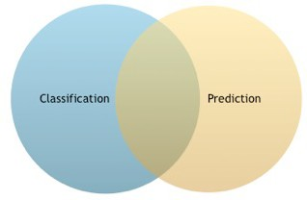
Purposes, intents, and limitations of Data Mining
What does Data Mining do?
Classification Models
Group data into similar classes
Prediction Models
Transform descriptions into expectations
Can overlap in some models

Slide 39
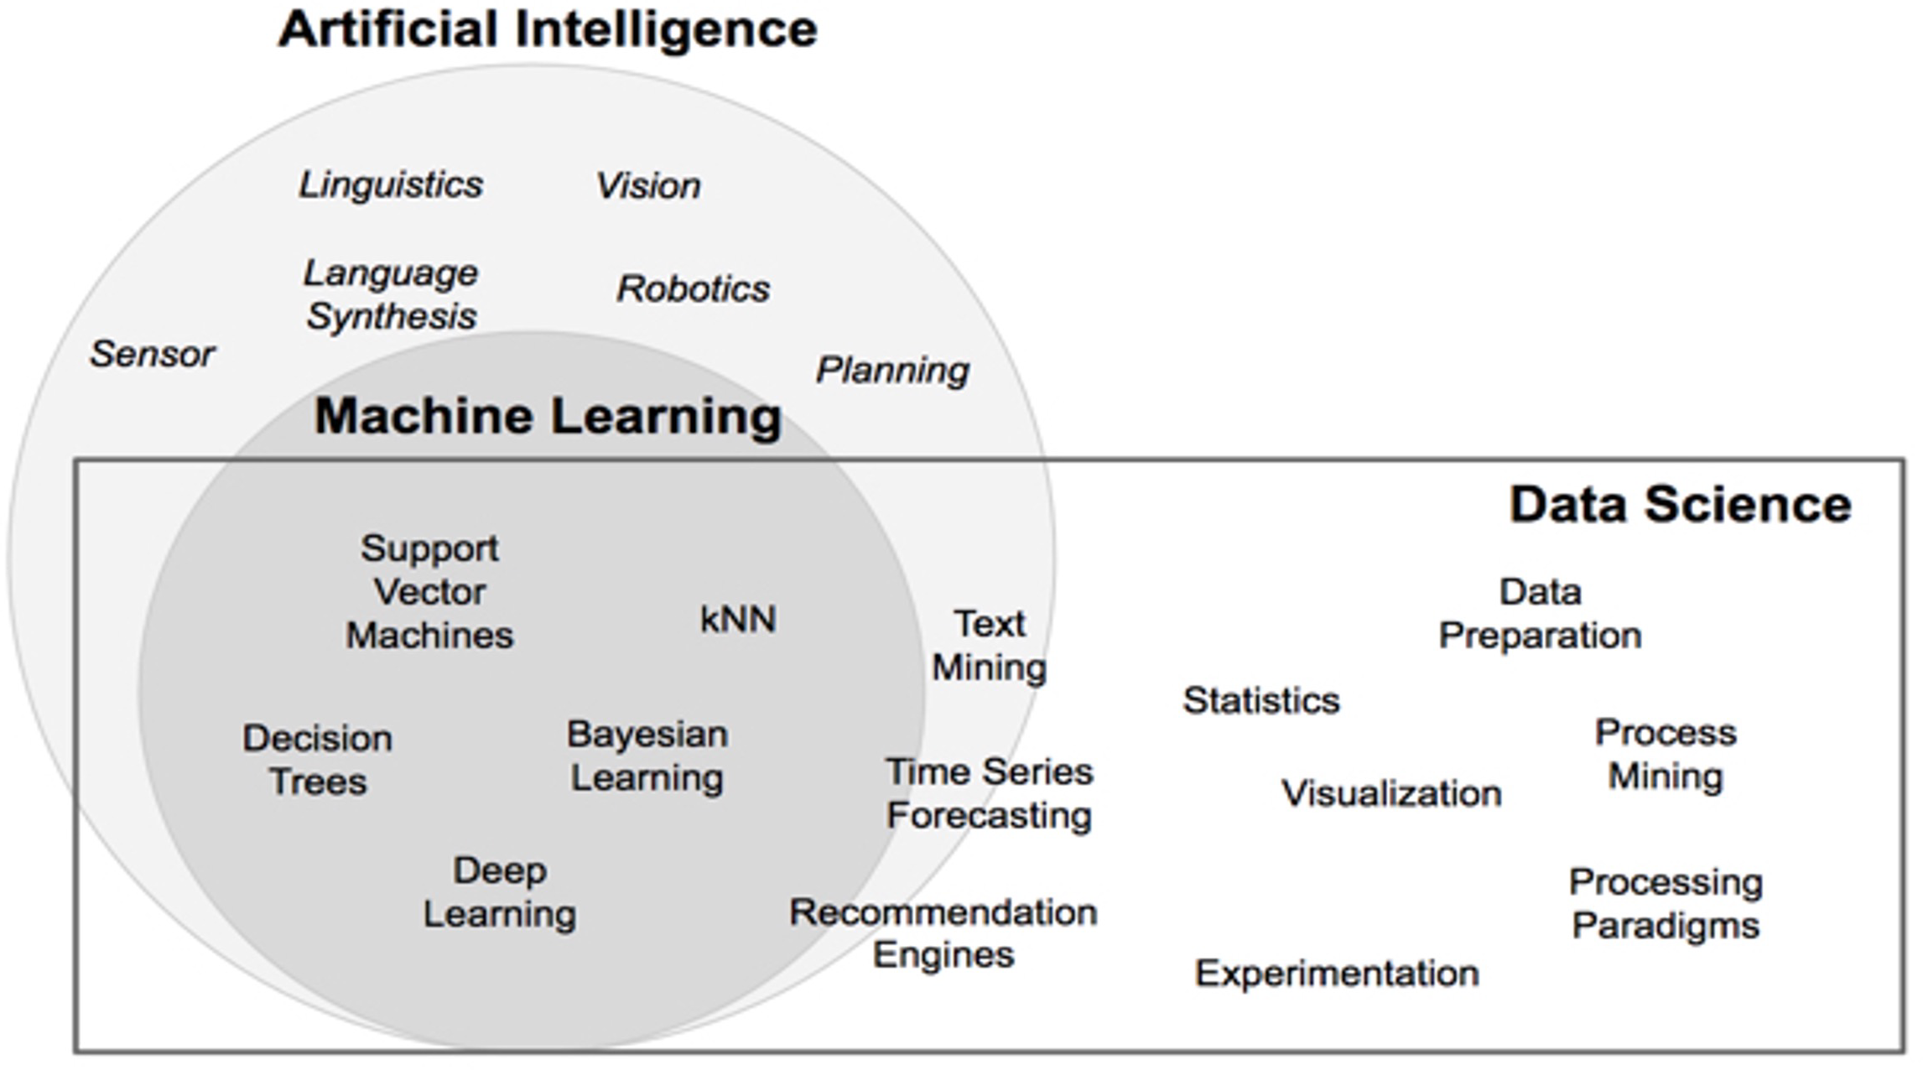
Data Science – Data Mining - AI
Source: Kotu,V., Deshpande, B. 2019, Data Science: Concepts and Practice with RapidMiner, Morgan Kaufmann Publishers.

Slide 40
Problem-Solving Questions
1. What is the relationship between Data Science, Machine Learning, and Artificial Intelligence?
Answer:
Artificial Intelligence (AI) is the broad field that focuses on creating systems capable of simulating human intelligence, such as reasoning, problem-solving, and learning.
Machine Learning (ML) is a subset of AI that enables systems to learn patterns from data and make predictions without being explicitly programmed.
Data Science is the interdisciplinary field that combines statistics, programming, and domain knowledge to extract insights from data. It often utilizes ML techniques to build predictive models.

Slide 41
Problem-Solving Questions
1. What is the relationship between Data Science, Machine Learning, and Artificial Intelligence?
Example:
AI: Self-driving cars using AI for navigation.
ML: Netflix recommending shows based on your watch history.
Data Science: Banks detecting fraudulent transactions using large-scale data analysis.

Slide 42
Problem-Solving Questions
2. How does Text Mining differ from traditional data analysis? Can you give real-world applications?
Answer:
Traditional data analysis primarily focuses on structured numerical data, using statistical methods to uncover patterns.
Text Mining, on the other hand, processes unstructured text data by extracting meaningful information through techniques like Natural Language Processing (NLP).

Slide 43
Problem-Solving Questions
2. How does Text Mining differ from traditional data analysis? Can you give real-world applications?
Real-world Applications:
Customer Sentiment Analysis – Companies analyze customer reviews on platforms like Amazon to understand satisfaction levels.
Spam Detection – Email providers use text classification to filter out spam emails.
Legal Document Analysis – AI-powered tools help scan legal contracts for key clauses and risks.
Healthcare – Extracting insights from doctors’ notes in patient records.

Slide 44
Problem-Solving Questions
3. Where do Deep Learning and Decision Trees fit into Machine Learning, and how are they used in industry?
Answer:
Decision Trees: A simple ML algorithm that makes decisions based on feature-based splitting (e.g., “Is the customer over 50? Yes → Predict high insurance premium”).
Deep Learning: A subset of ML that uses neural networks with multiple layers to process complex patterns in data.

Slide 45
Problem-Solving Questions
3. Where do Deep Learning and Decision Trees fit into Machine Learning, and how are they used in industry?
Industry Applications:
Decision Trees:
Credit scoring in banking.
Diagnosing diseases based on patient symptoms.
Deep Learning:
Self-driving cars using image recognition.
Chatbots like ChatGPT understanding and responding to text.
Fraud detection using anomaly detection in financial transactions.

Slide 46
Problem-Solving Questions
4. Why is Data Preparation a crucial step in Data Science? What challenges arise when preparing data?
Answer:
Data Preparation ensures that raw data is cleaned, formatted, and structured before analysis, improving model accuracy.
Challenges in Data Preparation:
Handling Missing Data – Filling missing values appropriately (mean imputation, deletion, interpolation).
Data Cleaning – Removing duplicates, correcting inconsistent data.
Feature Engineering – Transforming raw data into meaningful features.
Encoding Categorical Data – Converting text labels into numerical values (e.g., ‘Male’ → 0, ‘Female’ → 1).

Slide 47
Problem-Solving Questions
4. Why is Data Preparation a crucial step in Data Science? What challenges arise when preparing data?
Example: In healthcare, preparing patient data requires filling in missing test results, normalizing measurement units, and ensuring consistent terminology.

Slide 48
Problem-Solving Questions
5. How do recommendation engines work, and where do we see them in daily life (e.g., Netflix, Amazon, Spotify)?
Answer: Recommendation engines analyze user preferences and behaviors to suggest relevant items.
Types of Recommendation Systems:
Collaborative Filtering – Uses past user interactions to recommend items.
Example: Netflix suggests movies based on similar users' viewing history.
Content-Based Filtering – Recommends based on item attributes.
Example: Spotify recommends songs similar to those you’ve liked.
Hybrid Models – Combines both approaches for better accuracy.
Example: Amazon suggesting "Customers who bought this also bought…"

Slide 49
Problem-Solving Questions
5. How do recommendation engines work, and where do we see them in daily life (e.g., Netflix, Amazon, Spotify)?
Applications:
E-commerce (Amazon) – Product recommendations based on purchase history.
Social Media (YouTube, TikTok) – Video recommendations based on watch time.
Healthcare – Suggesting personalized treatment plans for patients.

Slide 50
Problem-Solving Questions
6. How do AI-powered sensors contribute to real-world applications such as self-driving cars or smart cities?
Answer: AI-powered sensors collect real-time data, process it, and make decisions.
Applications:
Self-driving Cars – AI-powered LiDAR and cameras detect road signs, pedestrians, and obstacles.
Smart Cities – AI-based traffic sensors optimize traffic signals, reducing congestion.
Healthcare – Wearable sensors monitor heart rate and predict medical conditions.
Agriculture – Smart irrigation systems use AI sensors to optimize water usage.

Slide 51
Problem-Solving Questions
7. Can you think of a case where AI-powered robotics are improving business processes?
Answer: Yes! AI-powered robotics are transforming industries.
Examples:
Manufacturing – Automated robots in Tesla factories assemble cars efficiently.
Logistics & Warehousing – Amazon’s robotic fulfillment centers sort and move packages.
Healthcare – AI-assisted robotic surgery improves precision (e.g., da Vinci Surgical System).
Food Industry – AI-powered robotic chefs automate food preparation in restaurants.

Slide 52
Final Thoughts
Data Science, AI, and Machine Learning are deeply interconnected and are revolutionizing industries worldwide. Understanding these concepts prepares students to apply them in practical real-world scenarios in Australia and globally.

Slide 53
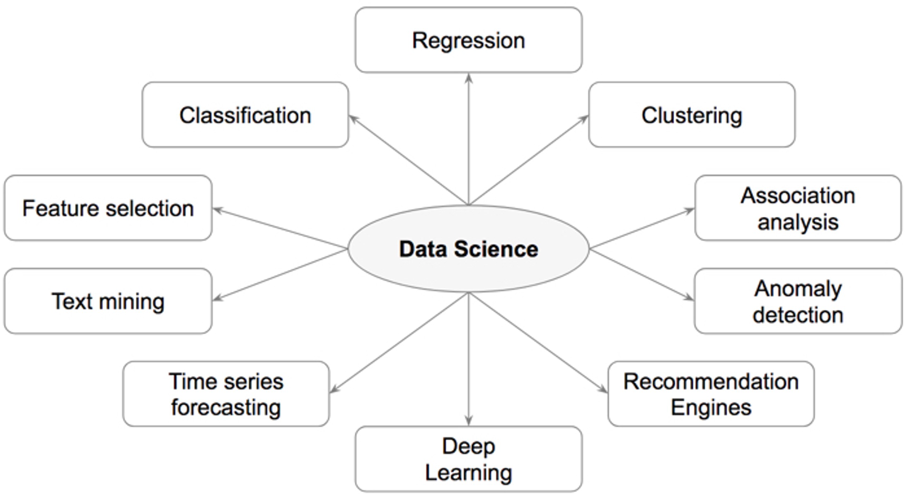
Types of Data Science
Source: Kotu,V., Deshpande, B. 2019, Data Science: Concepts and Practice with RapidMiner, Morgan Kaufmann Publishers.

Slide 54
Tasks | Description | Algorithms | Examples
Classification | Predict if a data point belongs to one of predefined classes. The prediction will be based on learning from known data set. | Decision Trees, Neural networks, Bayesian models, Induction rules, K nearest neighbors | Assigning voters into known buckets by political parties eg: soccer moms. Bucketing new customers into one of known customer groups.
Regression | Predict the numeric target label of a data point. The prediction will be based on learning from known data set. | Linear regression, Logistic regression | Predicting unemployment rate for next year. Estimating insurance premium.
Anomaly detection | Predict if a data point is an outlier compared to other data points in the data set. | Distance based, Density based, LOF | Fraud transaction detection in credit cards. Network intrusion detection.
Time series | Predict if the value of the target variable for future time frame based on history values. | Exponential smoothing, ARIMA, regression | Sales forecasting, production forecasting, virtually any growth phenomenon that needs to be extrapolated
Clustering | Identify natural clusters within the data set based on inherit properties within the data set. | K means, density based clustering - DBSCAN | Finding customer segments in a company based on transaction, web and customer call data.
Association analysis | Identify relationships within an itemset based on transaction data. | FP Growth, Apriori | Find cross selling opportunities for a retailor based on transaction purchase history.
Source: Kotu,V., Deshpande, B. 2019, Data Science: Concepts and Practice with RapidMiner, Morgan Kaufmann Publishers.

Slide 55
Data Science
Data science is a multidisciplinary field that encompasses various types of activities and skills. The different types of data science can be categorized based on the primary focus or application. Here are some key types of data science:
Descriptive Analytics:
Focus: Summarizing and interpreting historical data to describe what has happened.
Purpose: Providing insights into past trends, patterns, and key performance indicators.
Diagnostic Analytics:
Focus: Investigating data to understand why certain events occurred.
Purpose: Identifying the factors or variables that contributed to specific outcomes or trends.

Slide 56
Predictive Analytics:
Focus: Using historical data and statistical algorithms to make predictions about future events.
Purpose: Anticipating trends, behaviour, or outcomes based on patterns in the data.
Prescriptive Analytics:
Focus: Recommending actions to optimize outcomes or solve a particular problem.
Purpose: Providing actionable insights by suggesting the best course of action in a given situation.
Exploratory Data Analysis (EDA):
Focus: Investigating and visually exploring data to discover patterns, relationships, and outliers.
Purpose: Gaining a deeper understanding of the data and generating hypotheses for further analysis.

Slide 57
Machine Learning:
Focus: Building and deploying models that can learn from data and make predictions or decisions without explicit programming.
Purpose: Automation of analytical model building and leveraging algorithms for data- driven predictions.
Big Data Analytics:
Focus: Handling and analysing large volumes of data that traditional databases may struggle to process efficiently.
Purpose: Extracting valuable insights and patterns from massive datasets to inform decision-making.
Natural Language Processing (NLP):
Focus: Enabling machines to understand, interpret, and generate human language.
Purpose: Analysing and extracting information from text data, facilitating communication between computers and humans.

Slide 58
Image and Video Analysis:
Focus: Analysing visual data such as images and videos to extract information and patterns.
Purpose: Applications include image recognition, object detection, and video analysis.
Time Series Analysis:
Focus: Analysing data collected over time to identify patterns, trends, and seasonality.
Purpose: Commonly used in forecasting and understanding temporal patterns in data.
Geospatial Analytics:
Focus: Analysing and interpreting data with geographic components.
Purpose: Understanding spatial patterns, relationships, and trends for applications like mapping and location-based services.

Slide 59
Data Mining Discipline Overview
Core Algorithms
Classification Decision Trees Rule Induction
k-Nearest Neighbors Naïve Bayesian
Process Basics
Artificial Neural Networks Support Vector Machines Ensemble Learners Regression
Linear Regression Logistic Regression
Association Analysis
Apriori
FP-Growth Clustering k-Means DBSCAN
Self-Organizing Maps
Common Applications
Data Science Process
Data Exploration Model Evaluation
Text Mining
Time Series Forecasting Anomaly Detection Feature Selection
Source: Kotu,V., Deshpande, B. 2019, Data Science: Concepts and Practice with RapidMiner, Morgan Kaufmann Publishers.

Slide 60
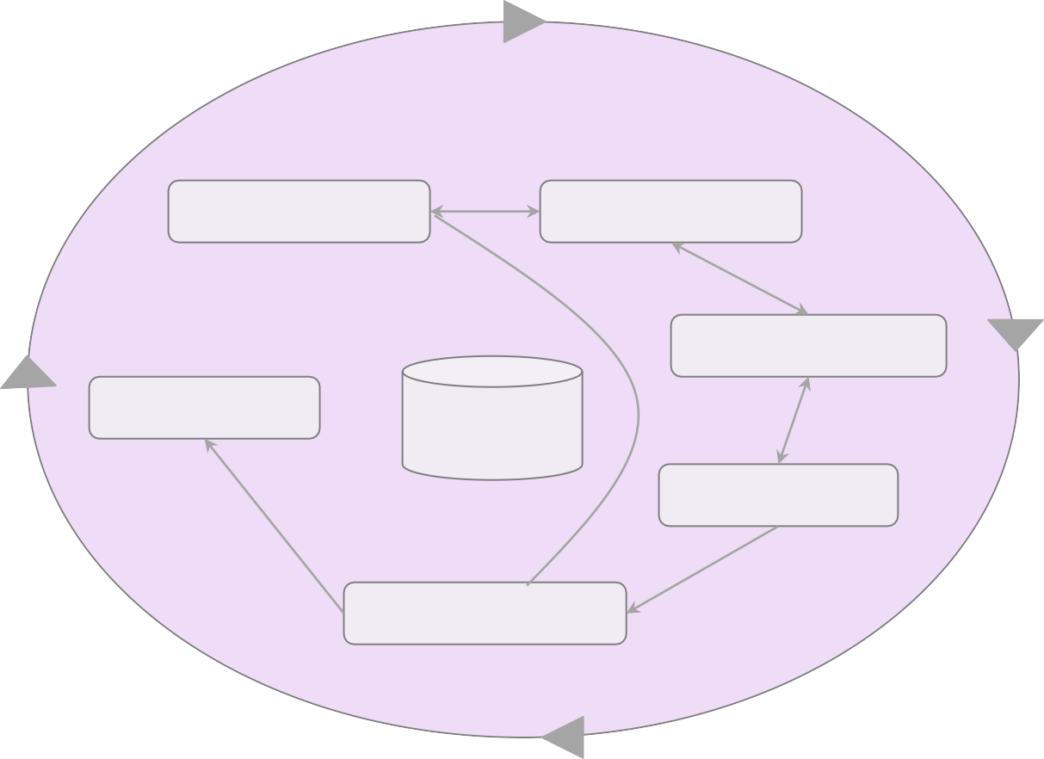
CRISP DM process
Business Understanding
Data Understanding
Data Preparation
Deployment
Data
Modeling
Evaluation

Slide 61
Process
Business Understanding
Data Understanding
1. Prior Knowledge
Prepare Data
2. Preparation
Training Data
Building Model using Algorithms
Applying Model and performance evaluation
3. Modeling
Test Data
Deployment
4. Application
Knowledge and Actions
5. Knowledge

Slide 62
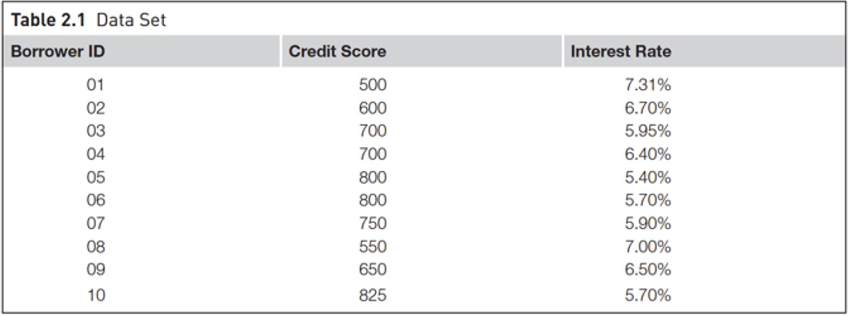
1. Prior Knowledge
Gaining information on:
-Objective of the problem
-Subject area of the problem
-Data

Slide 63
The Data Mining Process - CRISP-DM
Business (Organizational) Understanding
Define the questions you want to answer
Design what you are going to build
Data Understanding
What is the source of the data?
How was it collected?
How accurate or reliable is it?

Slide 64
Problem-Solving Question
A government agency wants to improve traffic management and reduce congestion in major cities. They plan to use data mining techniques to analyze past traffic patterns and predict future congestion hotspots.
Using the CRISP-DM framework, how should the agency approach this project, specifically focusing on Business Understanding and Data Understanding?

Slide 65
Problem-Solving Question
Example: Australia - Sydney Traffic Management
Business Understanding:
Goal: Reduce congestion and optimize traffic signal timings in Sydney.
Key Questions:
What are the peak congestion times and locations?
How do weather conditions and public events impact traffic flow?
Can predictive models help adjust traffic signals dynamically?

Slide 66
Problem-Solving Question
Data Understanding:
Source of Data:
Sydney Transport Open Data API
GPS data from ride-sharing services (Uber, Ola, DiDi)
CCTV footage and road sensors from Transport for NSW

Slide 67
Problem-Solving Question
Data Collection:
Live traffic feeds, toll booth logs, and public transport schedules
Historical accident reports and roadwork schedules

Slide 68
Problem-Solving Question
Accuracy & Reliability:
Real-time data needs validation against historical trends.
Incomplete GPS data may require interpolation techniques.

Slide 69
Problem-Solving Question
Example: Global - Air Pollution & Traffic in London
Business Understanding:
Goal: Reduce traffic-related air pollution in central London.
Key Questions:
Which areas have the highest levels of vehicle emissions?
How do different traffic policies (e.g., congestion charges) impact pollution levels?
Can traffic re-routing reduce pollution exposure for pedestrians?

Slide 70
Problem-Solving Question
Data Understanding:
Source of Data:
London Air Quality Network
Traffic density reports from the Transport for London (TfL)
Google Maps and Waze traffic patterns

Slide 71
Problem-Solving Question
Data Collection:
IoT sensors measuring real-time CO2 and NOx emissions
Historical traffic congestion data from TfL’s traffic monitoring system
Accuracy & Reliability:
IoT sensor data may have calibration errors.
Seasonal variations (e.g., winter heating emissions) must be accounted for.

Slide 72
Key Takeaway
Using CRISP-DM, both Sydney and London can define their problem statement (Business Understanding) and systematically analyze traffic and environmental data (Data Understanding) to develop data-driven policies for congestion management and pollution reduction.

Slide 73
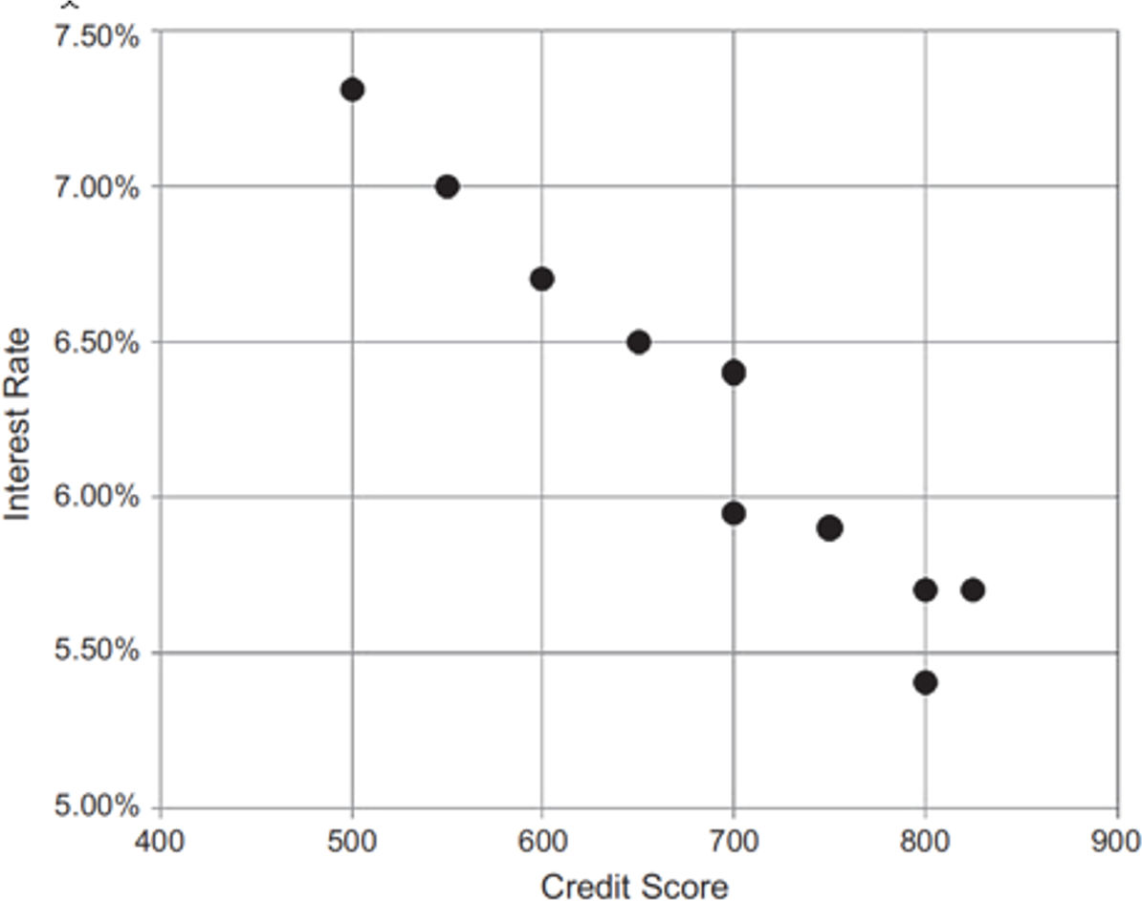
2. Data Preparation
A dataset
A data point
An attribute
A label
Identifiers
Data Exploration
Data quality
Handling missing values
Data type conversion
Transformation
Outliers
Feature selection
Sampling

Slide 74
3. Modeling
Training Data
Build model
Test Data
Evaluation
Final Model

Slide 75
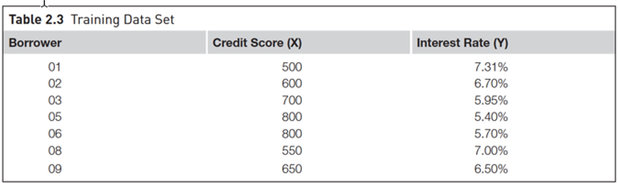
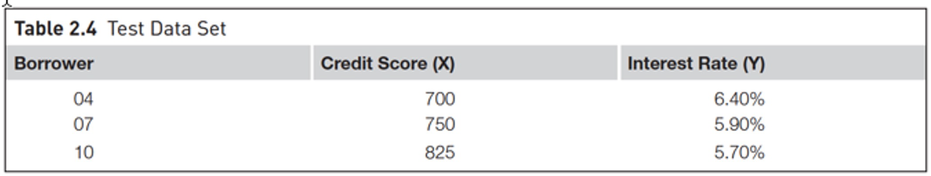
3. Modeling
Spliting training and test data sets

Slide 76
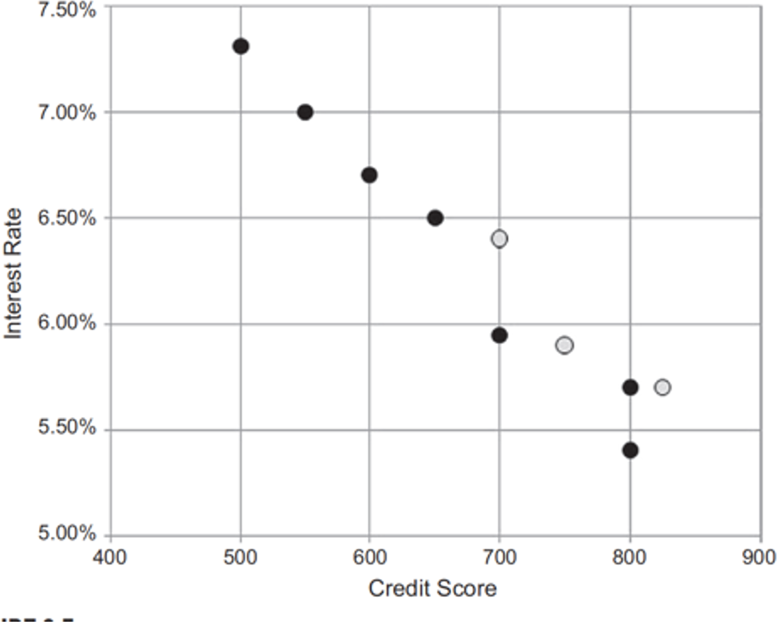
3. Modeling
Spliting training and test data sets
Training Data Test Data

Slide 77
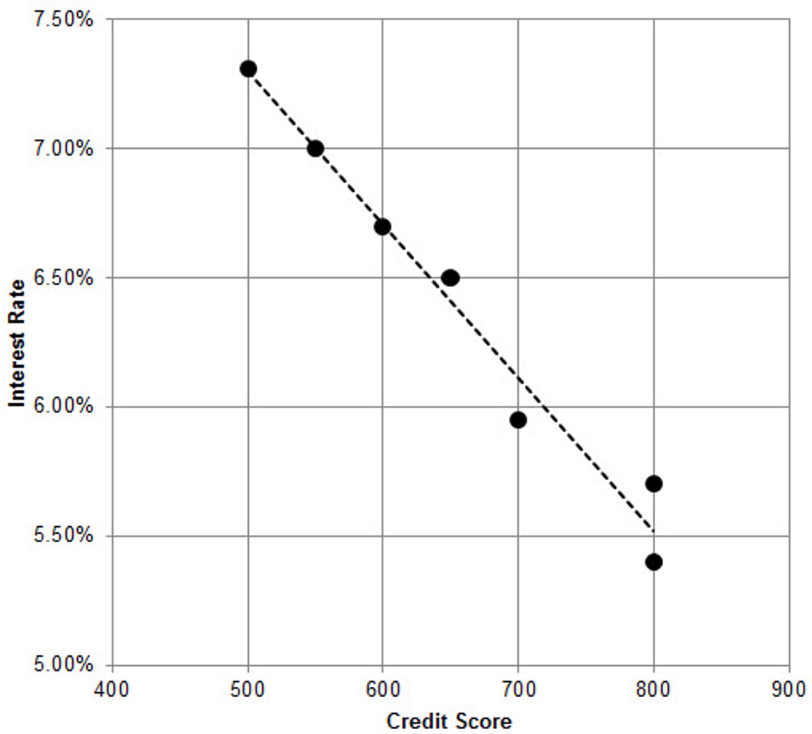
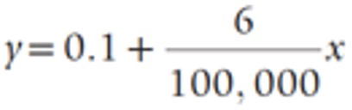
3. Modeling

Slide 78
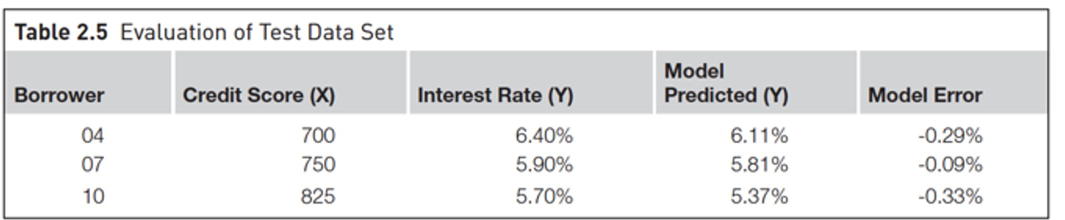
3. Modeling
Evaluation of test dataset

Slide 79
3. Application
Product readiness Technical integration Model response time Remodeling Assimilation
Deployment
Automation of model
Communication with end-users
Integration with existing systems
Continuous monitoring and gaining feedback for improvement (fine-tuning)

Slide 80
Keys to Successful Deployment
Clearly communicate model’s function and utility to stakeholders
Thoroughly test and prove the model
Plan for and monitor implementation

Slide 81
5. Knowledge
Posterior knowledge

Slide 82
Limits to Data Mining
Garbage In, Garbage Out (GIGO)
Collected incorrectly
Out-of-date
Use available resources, acceptable risk, professional experience, and common sense

Slide 83
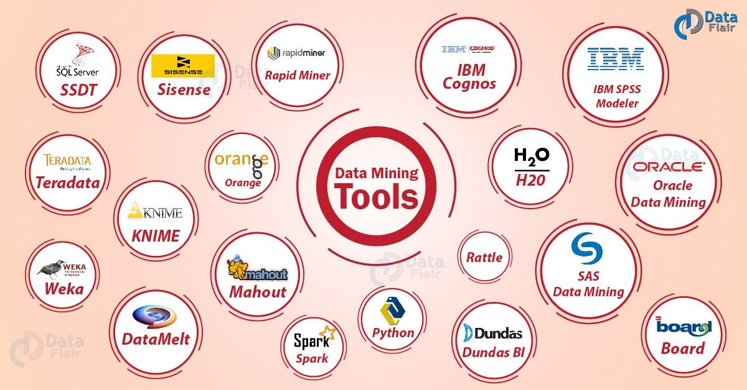
Data Mining Tools
Source: https://data-flair.training/blogs/data-mining-tools-techniques/

Slide 84
Step-by-step Instructions for Installing RapidMiner Studio
RapidMiner is a powerful data analytics platform that provides a visual workflow for data mining and machine learning tasks without the need for coding. Follow these steps to install RapidMiner Studio and activate a free educational license.

Slide 85
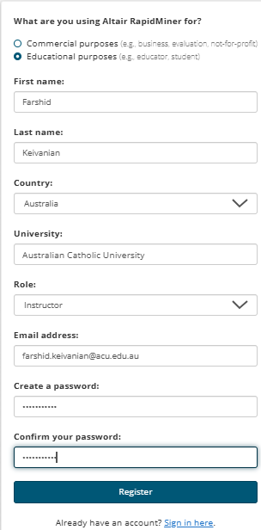
Step-by-step Instructions for Installing RapidMiner Studio
Step 1: Download RapidMiner Studio
Open a web browser and go to the RapidMiner Studio Sign-Up page. Use your University Account for the registration
Click on Sign Up and create an account using your ACU email address.

Slide 86
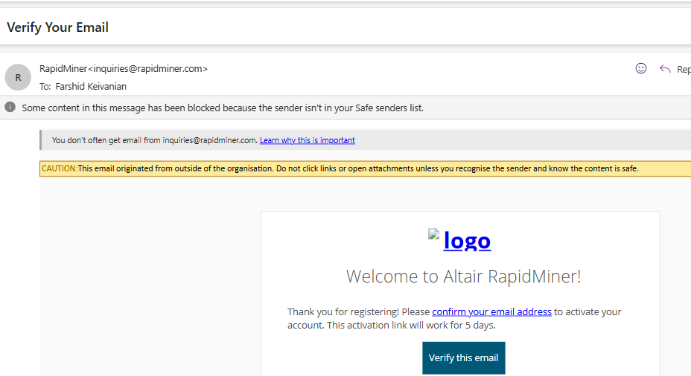
Step-by-step Instructions for Installing RapidMiner Studio
Verify Your Email

Slide 87
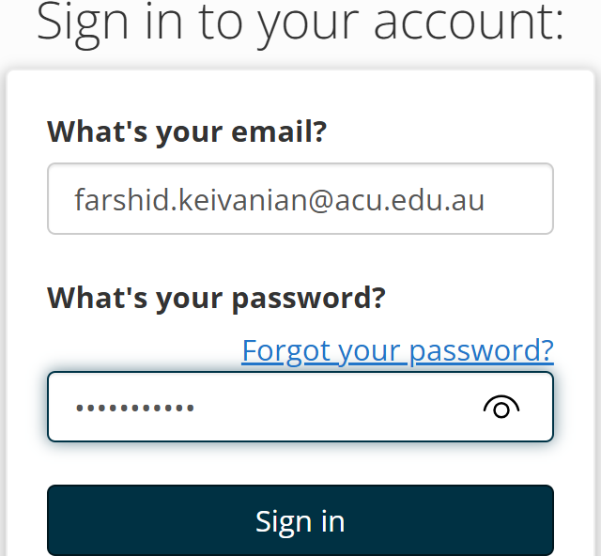
Step-by-step Instructions for Installing RapidMiner Studio
Sign in to your account

Slide 88
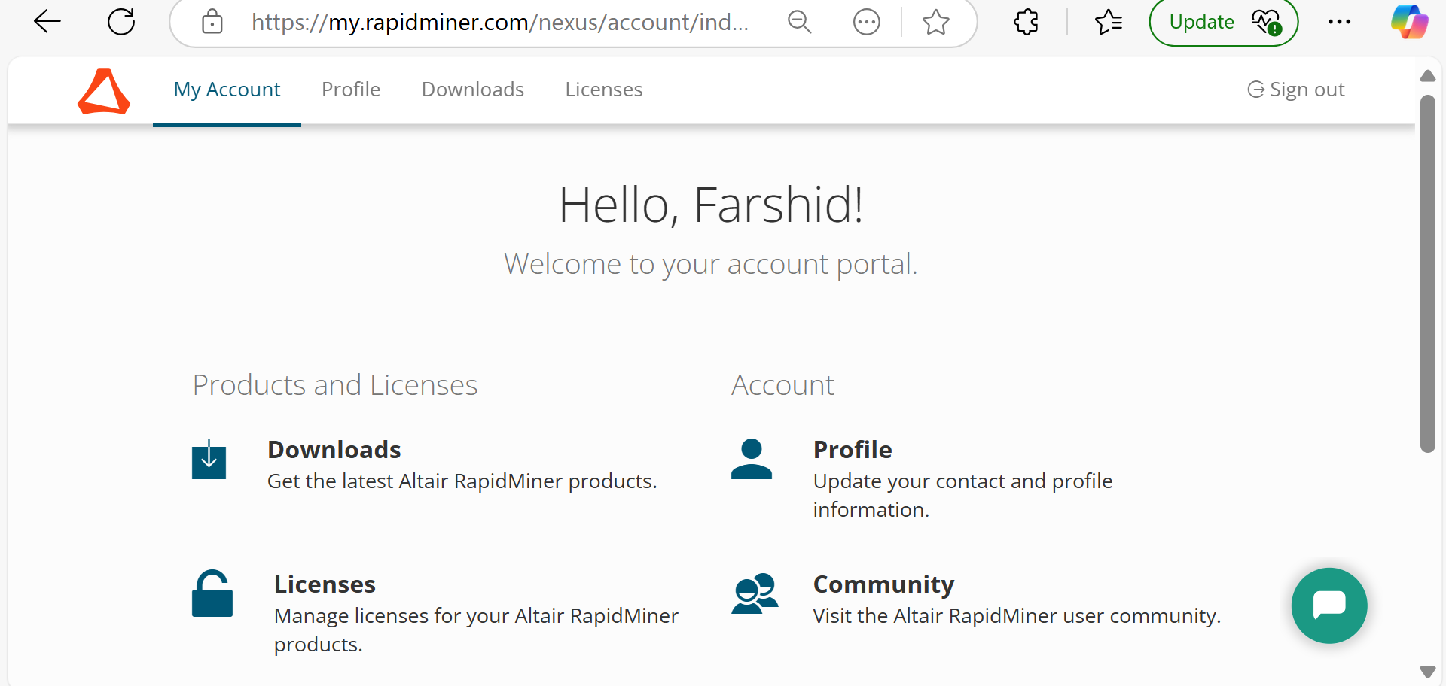
Step-by-step Instructions for Installing RapidMiner Studio
After signing up, log in and navigate to the Downloads section.

Slide 89
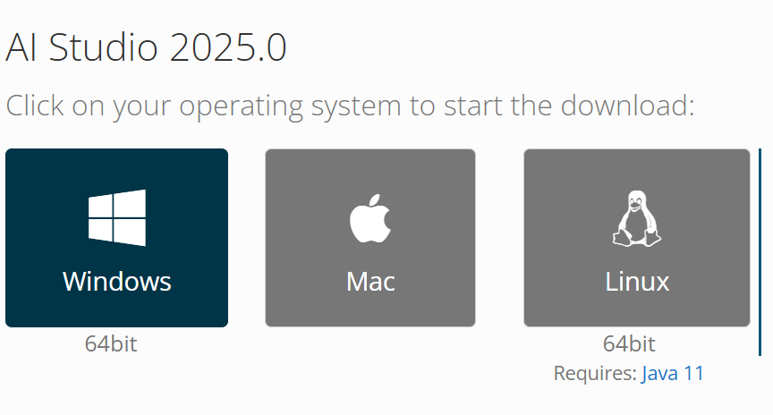
Step-by-step Instructions for Installing RapidMiner Studio
Select the appropriate version of RapidMiner Studio for your operating system:
Windows (.exe file)
macOS (.dmg file)
Linux (.sh file)
Click Download and wait for the file to be saved on your computer.

Slide 90
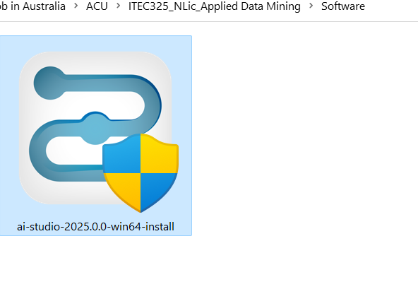
Step-by-step Instructions for Installing RapidMiner Studio
Click on Downloaded File to Install it

Slide 91
Step-by-step Instructions for Installing RapidMiner Studio
Step 2: Install RapidMiner Studio
On Windows:
Locate the downloaded .exe file and double-click to start the installer.
Follow the on-screen instructions to complete the installation.
Choose the default installation options unless you have specific preferences.
Click Finish to complete the setup.

Slide 92
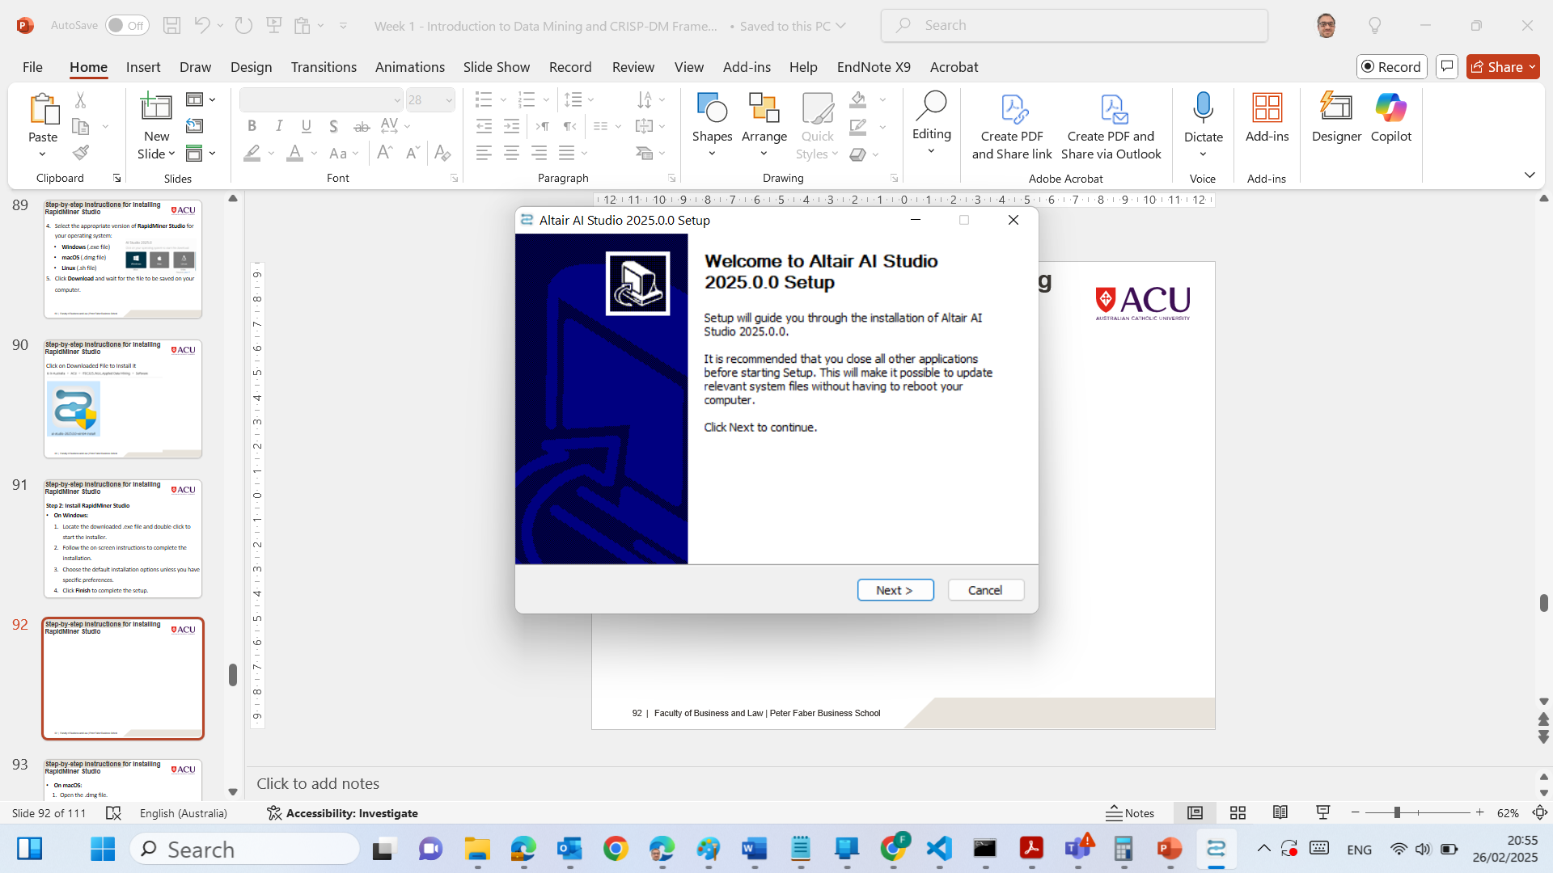
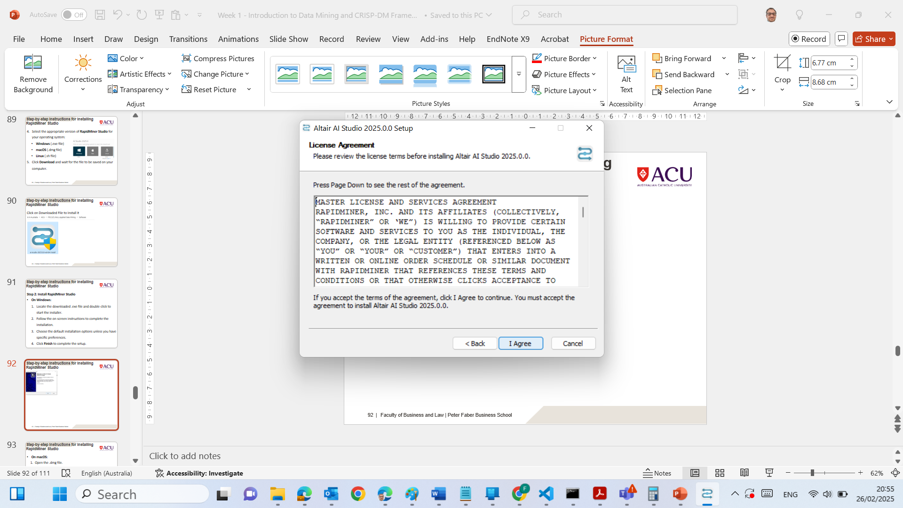
Step-by-step Instructions for Installing RapidMiner Studio
Next
I Agree

Slide 93
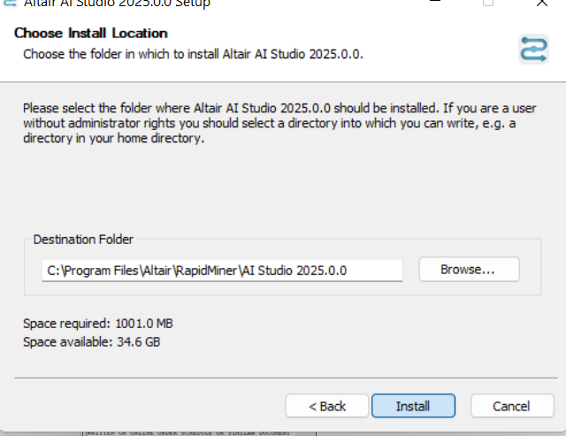
Step-by-step Instructions for Installing RapidMiner Studio
Install

Slide 94
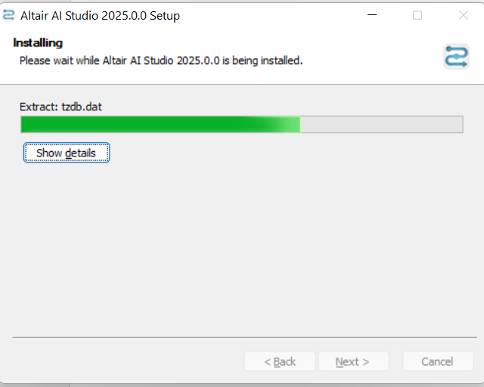
Step-by-step Instructions for Installing RapidMiner Studio
Wait Until the Installation is Completed

Slide 95
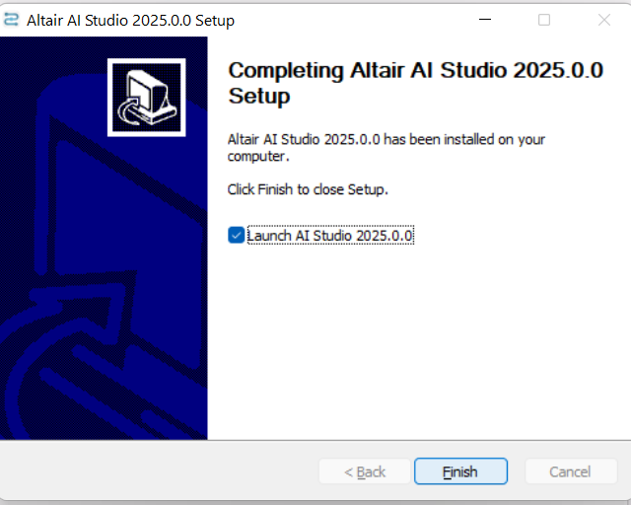
Step-by-step Instructions for Installing RapidMiner Studio
Launch the Software

Slide 96
Step-by-step Instructions for Installing RapidMiner Studio
On macOS:
Open the .dmg file.
Drag and drop RapidMiner Studio into the Applications folder.
Eject the installer and close the window.

Slide 97
Step-by-step Instructions for Installing RapidMiner Studio
On Linux:
Open a terminal and navigate to the folder where the .sh file is located.
Run the following command to install
chmod +x RapidMiner-Studio.sh
./RapidMiner-Studio.sh
Follow the on-screen instructions to complete the installation.

Slide 98
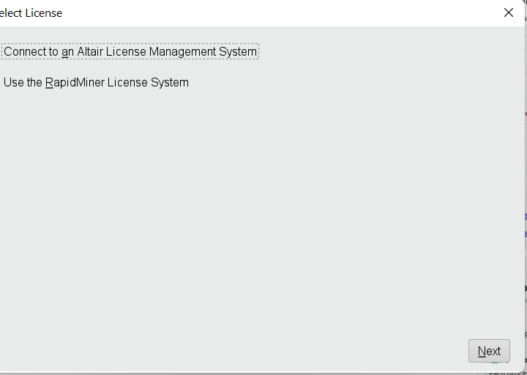
Step-by-step Instructions for Installing RapidMiner Studio
Choose the 2nd one ‘RapidMiner License System)

Slide 99
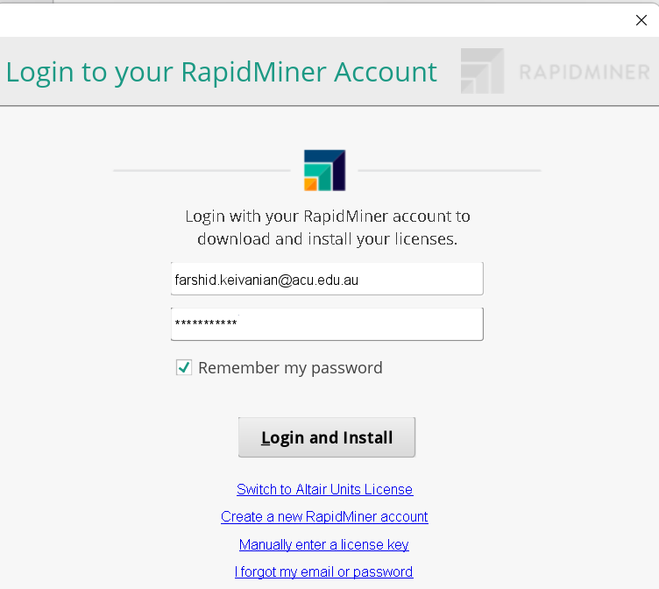
Step-by-step Instructions for Installing RapidMiner Studio
Login to your account using the same user and pass

Slide 100

Step-by-step Instructions for Installing RapidMiner Studio
Launch the Software and Close Welcome Page

Slide 101
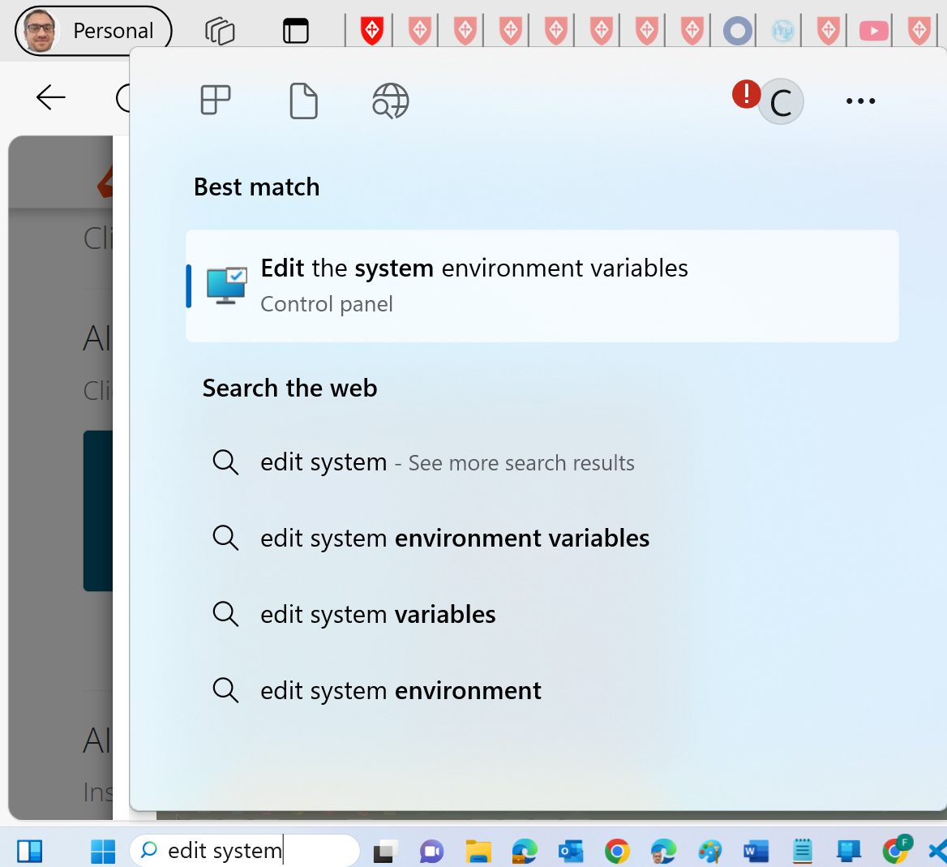
Step-by-step Instructions for Installing RapidMiner Studio
This step is only for those who have purchased a license (not for our students): Run System Environment Variables

Slide 102
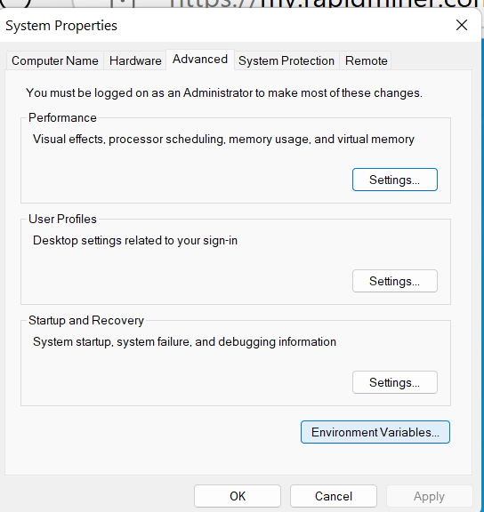
Step-by-step Instructions for Installing RapidMiner Studio
This step is only for those who have purchased a license (not for our students): Click on Environment Variables to Set Up it

Slide 103
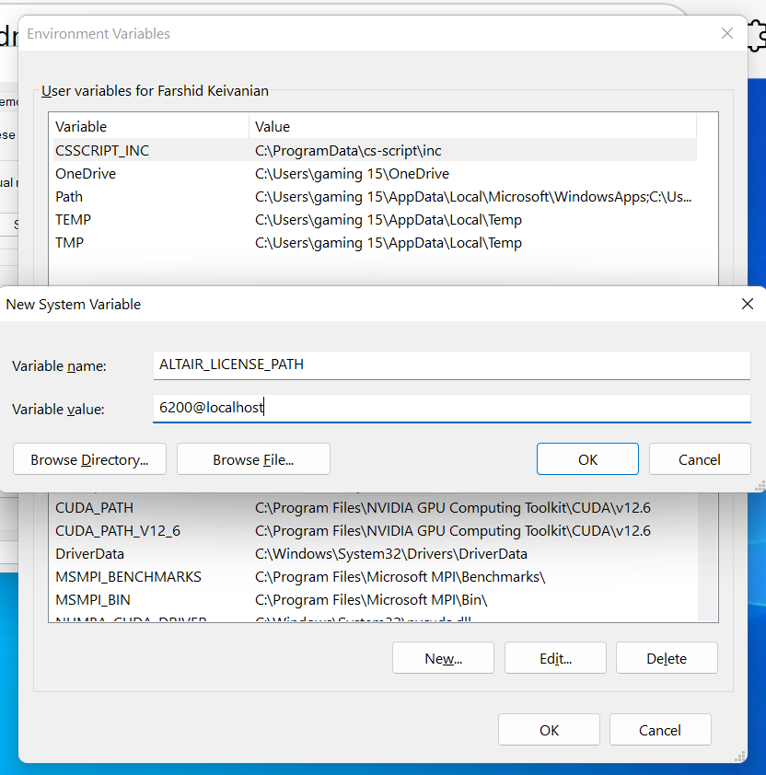
Step-by-step Instructions for Installing RapidMiner Studio
This step is only for those who have purchased a license (not for our students): Create a New System Variable Then OK

Slide 104
Step-by-step Instructions for Installing RapidMiner Studio
Step 3: Activate the Educational License
Launch RapidMiner Studio after installation.
When prompted to activate, choose Sign In and enter the credentials for the account you created earlier.
RapidMiner will detect your educational email and apply a 1-year renewable educational license automatically.
If the license does not activate, visit RapidMiner Educational Program and request a license manually.

Slide 105
Step-by-step Instructions for Installing RapidMiner Studio
Step 4: Verify Installation
Open RapidMiner Studio and check if the interface loads properly.
Go to Help → About to confirm that the Educational License is activated.
Ensure that all features are unlocked and that data analysis is not restricted to 10,000 rows.

Slide 106
Step-by-step Instructions for Installing RapidMiner Studio
Now you are ready to use RapidMiner Studio for your data mining tasks!

Slide 107
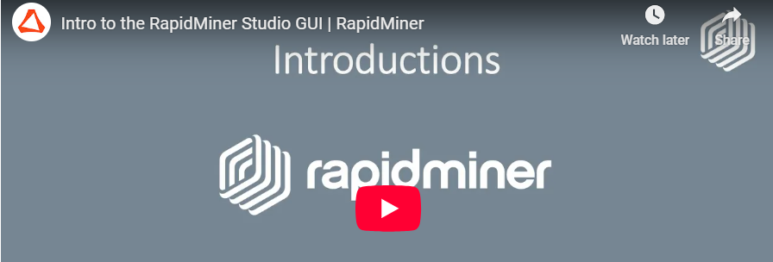
Step-by-step Instructions for Installing RapidMiner Studio
1. Overview of RapidMiner Studio
RapidMiner is a visual data analytics platform that does not require coding.
It includes automated features for data preparation, modeling, validation, and deployment.
Two key modes:
Design View (for process creation)
Results View (for data output and analysis)
https://youtu.be/Gg01mmR3j-g

Slide 108
Step-by-step Instructions for Installing RapidMiner Studio
2. Key Components of the Interface
Design View: Where you build and modify analytical processes.
Process Panel: The central workspace where operators are connected to create workflows.
Operators Panel: A toolbox containing different data science functions categorized into:
Data Access
Blending
Cleansing
Modeling
Evaluation, etc.

Slide 109
Step-by-step Instructions for Installing RapidMiner Studio
Repository Panel: Stores data and processes; best practice is to create:
A Data folder (for datasets)
A Processes folder (for workflows)

Slide 110
Step-by-step Instructions for Installing RapidMiner Studio
3. Building a Simple Process
Steps to create a process:
Drag an operator (e.g., "Retrieve") into the Process Panel.
Use Global Search to quickly find an operator.
Configure settings in the Parameters Panel (top right).
Connect the ports (half-circle icons) to ensure data flows correctly.
Run the process and view the output in Results View.

Slide 111
Step-by-step Instructions for Installing RapidMiner Studio
4. Understanding Results View
Displays output data as a table.
Data structure:
Examples (rows)
Attributes (columns)
Includes additional options like:
Statistics (e.g., missing values)
Visualizations (graphs and charts)
Annotations (notes for documentation)

Slide 112
Step-by-step Instructions for Installing RapidMiner Studio
5. Customizing the Panel Layout
Resize panels by dragging boundaries.
Reposition panels by dragging tabs.
Restore default settings via View > Restore Default View.
6. Finding Help & Tutorials
Help Panel (bottom right): Displays explanations for each operator.
Some operators include tutorial processes that provide step-by-step examples.

Slide 113
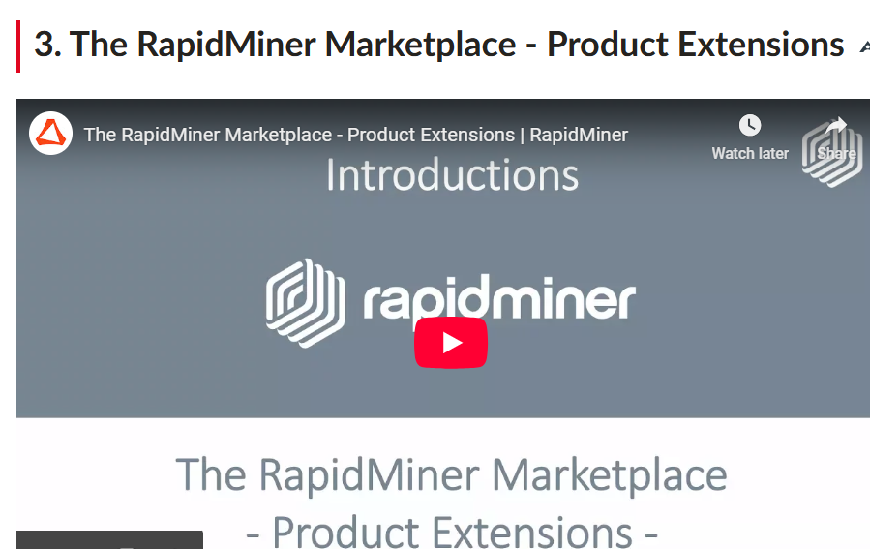
RapidMiner Studio - Extensions
https://youtu.be/pjBqG3xtXx4
1. What are Extensions in RapidMiner?
Extensions add extra functionalities to RapidMiner Studio.
Available through the RapidMiner Marketplace.
Allow integration with external tools like Python, R, Hadoop, and provide additional features like Text Processing and Web Mining.

Slide 114
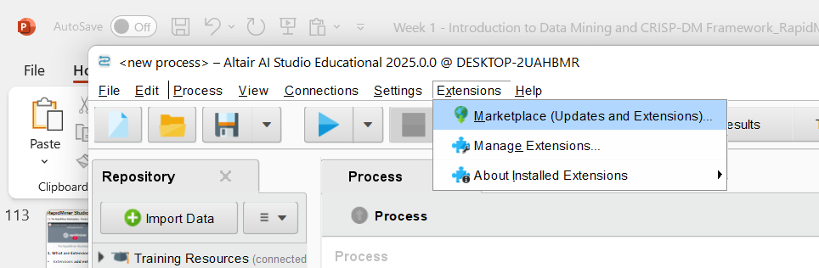
RapidMiner Studio - Extensions
https://youtu.be/pjBqG3xtXx4
2. How to Install Extensions
Access the Marketplace:
Navigate to Extensions > Marketplace from the menu.
The Marketplace dialog will appear.

Slide 115
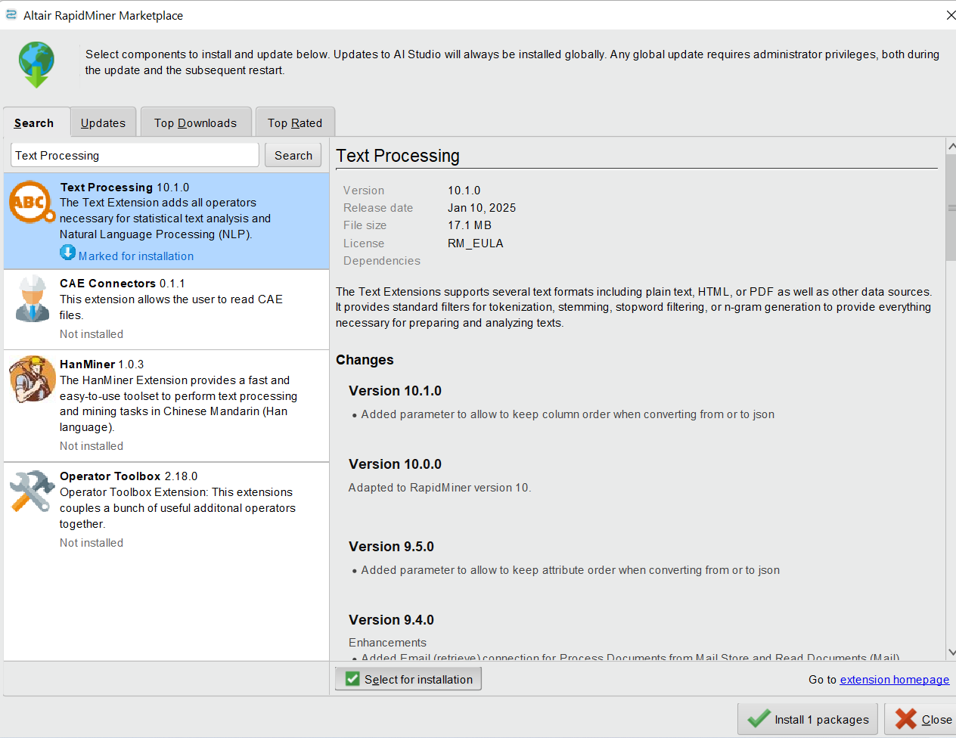
RapidMiner Studio - Extensions
2. Search and Select Extensions:
Use the search option to find extensions by name or keyword.
Popular extensions include:
Text Processing
Web Mining
Python & R Integration
Anomaly Detection
Series Extension
Radoop (for Hadoop support)

Slide 116
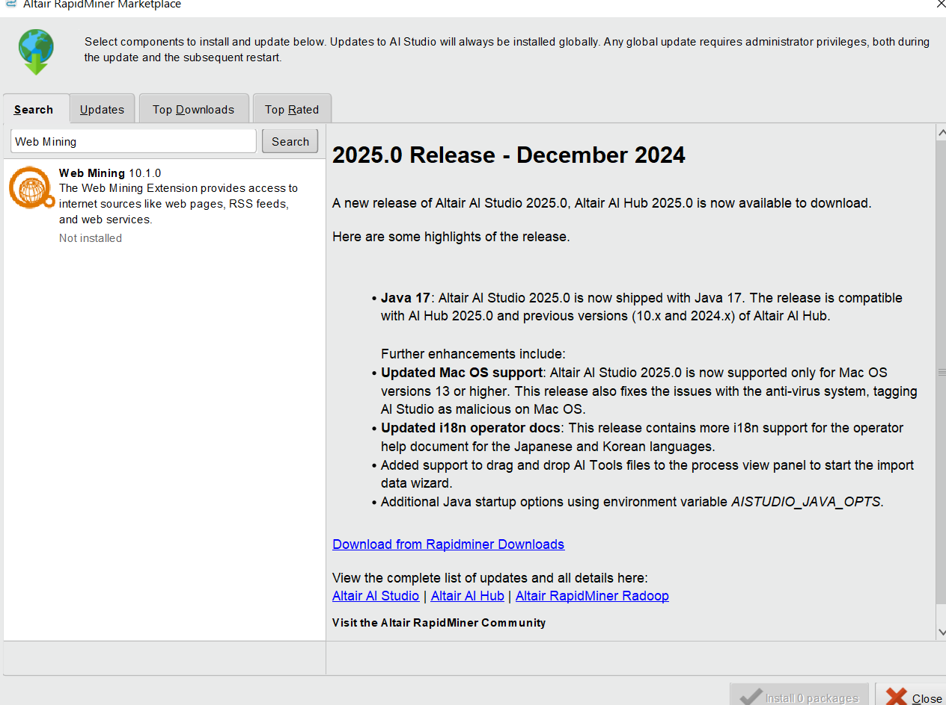
RapidMiner Studio - Extensions
2. Search and Select Extensions:
Use the search option to find extensions by name or keyword.
Popular extensions include:
Text Processing
Web Mining
Python & R Integration
Anomaly Detection
Series Extension
Radoop (for Hadoop support)

Slide 117
RapidMiner Studio - Extensions
2. Search and Select Extensions:
Use the search option to find extensions by name or keyword.
Popular extensions include:
Text Processing
Web Mining
Python & R Integration
Anomaly Detection
Series Extension
Radoop (for Hadoop support)

Slide 118
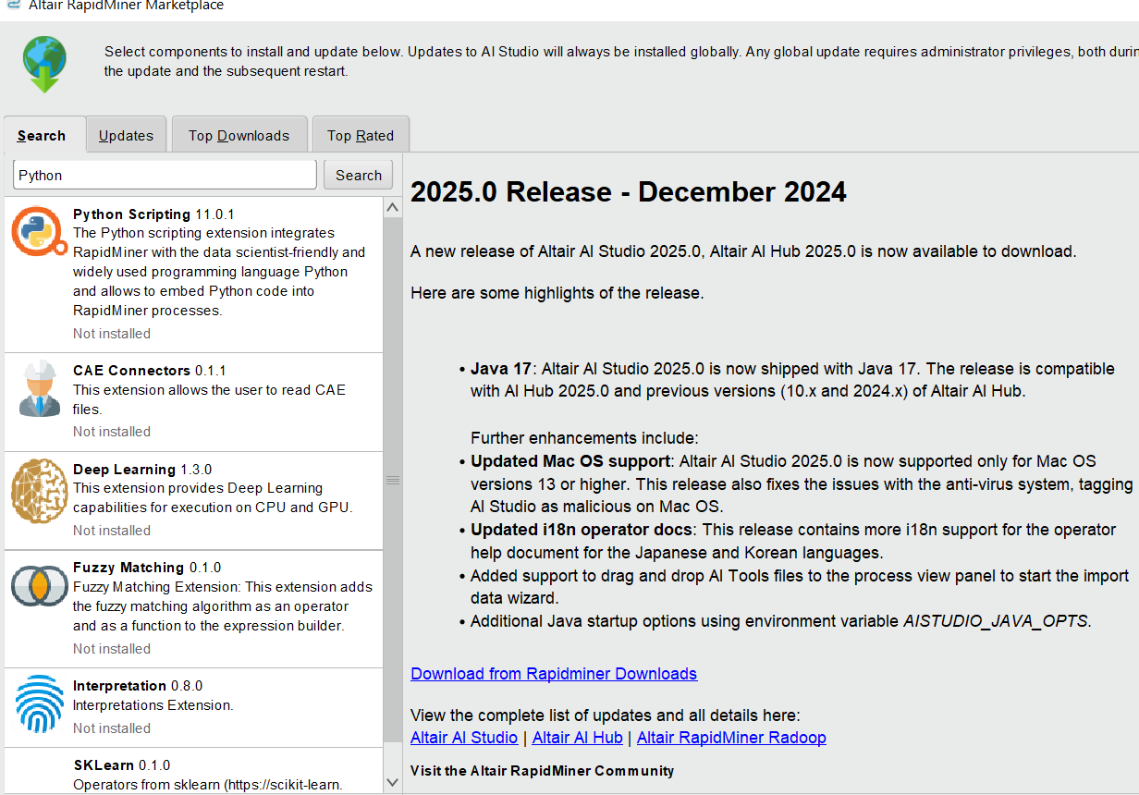
RapidMiner Studio - Extensions
2. Search and Select Extensions:
Use the search option to find extensions by name or keyword.
Popular extensions include:
Text Processing
Web Mining
Python & R Integration
Anomaly Detection
Series Extension
Radoop (for Hadoop support)

Slide 119
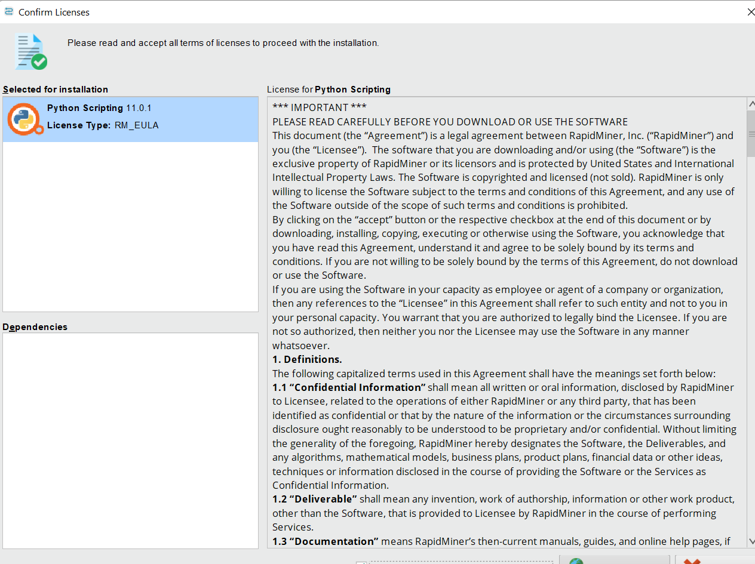
RapidMiner Studio - Extensions
2. Search and Select Extensions:
Use the search option to find extensions by name or keyword.
Popular extensions include:
Text Processing
Web Mining
Python & R Integration
Anomaly Detection
Series Extension
Radoop (for Hadoop support)

Slide 120
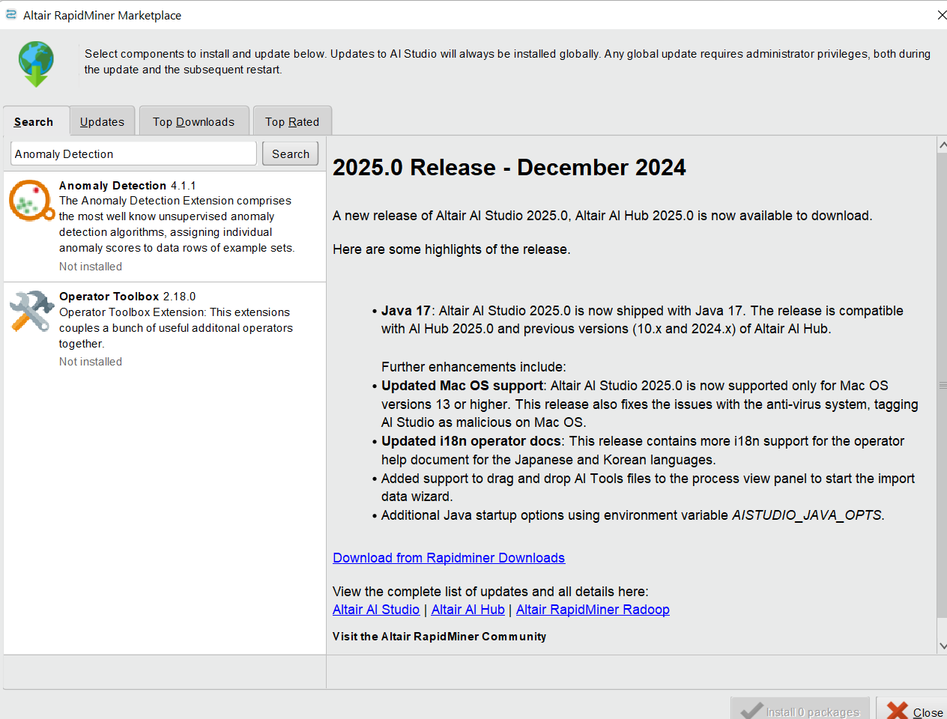
RapidMiner Studio - Extensions
2. Search and Select Extensions:
Use the search option to find extensions by name or keyword.
Popular extensions include:
Text Processing
Web Mining
Python & R Integration
Anomaly Detection
Series Extension
Radoop (for Hadoop support)

Slide 121
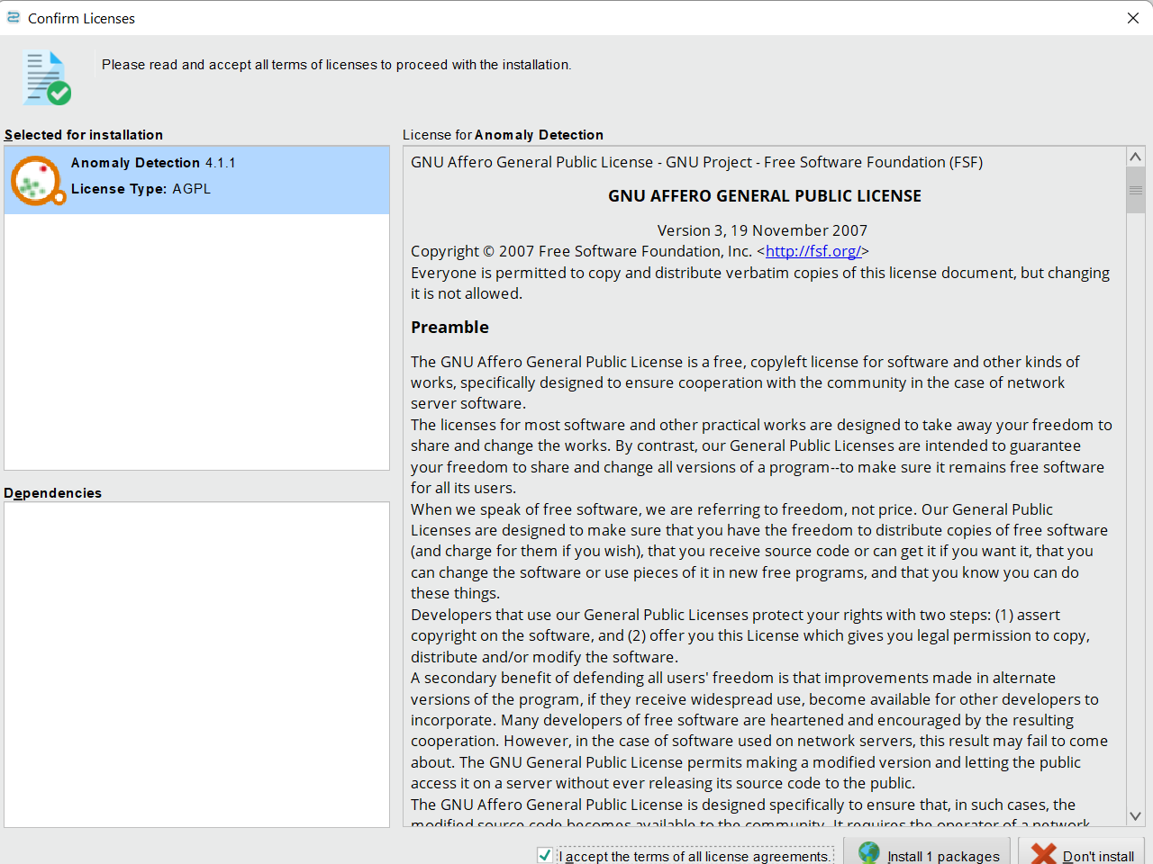
RapidMiner Studio - Extensions
2. Search and Select Extensions:
Use the search option to find extensions by name or keyword.
Popular extensions include:
Text Processing
Web Mining
Python & R Integration
Anomaly Detection
Series Extension
Radoop (for Hadoop support)

Slide 122
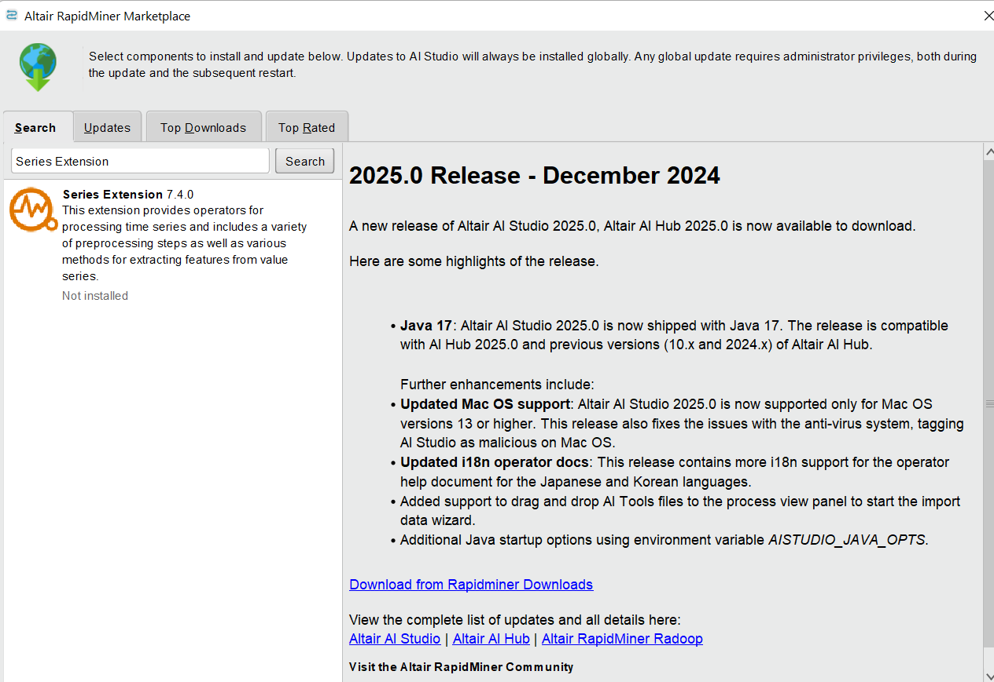
RapidMiner Studio - Extensions
2. Search and Select Extensions:
Use the search option to find extensions by name or keyword.
Popular extensions include:
Text Processing
Web Mining
Python & R Integration
Anomaly Detection
Series Extension
Radoop (for Hadoop support)

Slide 123
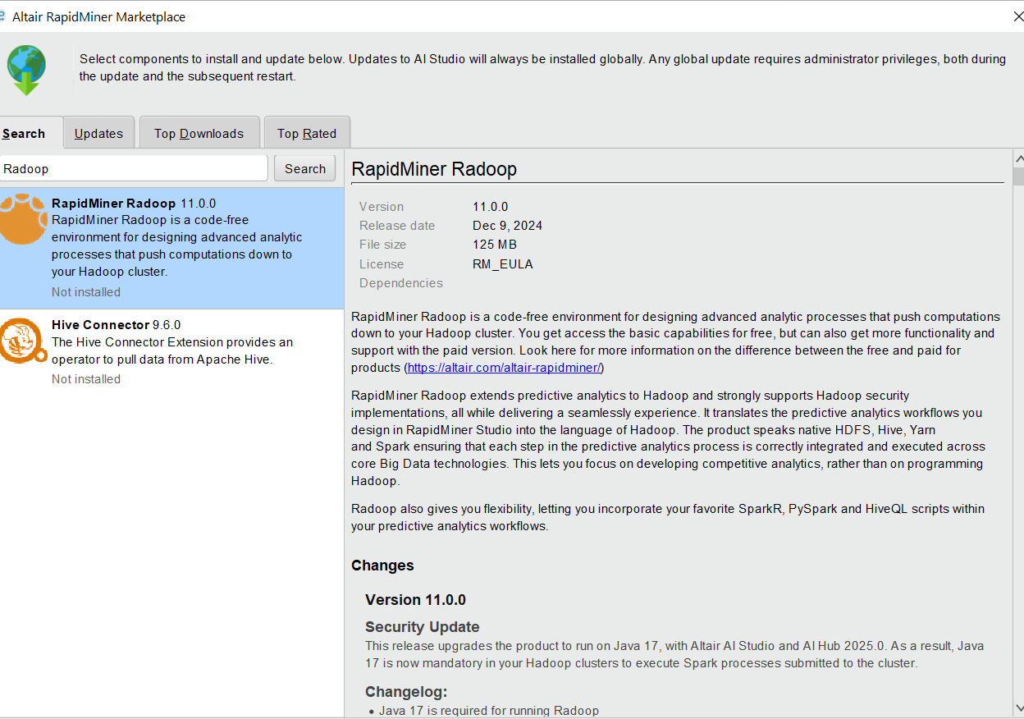
RapidMiner Studio - Extensions
2. Search and Select Extensions:
Use the search option to find extensions by name or keyword.
Popular extensions include:
Text Processing
Web Mining
Python & R Integration
Anomaly Detection
Series Extension
Radoop (for Hadoop support)

Slide 124
RapidMiner Studio - Extensions
Installing Extensions:
Select an extension and check the box for installation.
Some extensions require dependencies (e.g., Web Mining also installs Text Processing automatically).
Confirm the installation and accept the license agreements.
RapidMiner will download and install the extension.

Slide 125

RapidMiner Studio - Extensions
4. Restart RapidMiner Studio
After installation, restart RapidMiner to activate new extensions.
Installed extensions will appear as new folders in the Operators Panel.

Slide 126
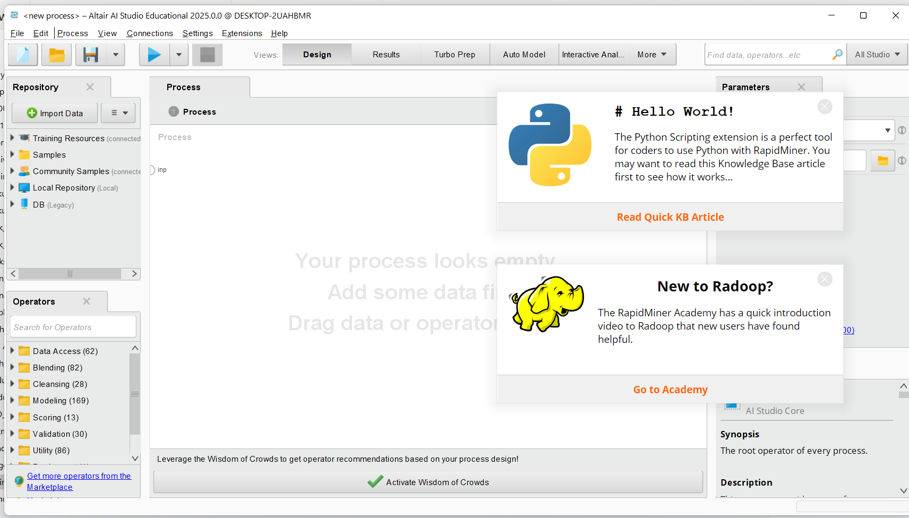
RapidMiner Studio - Extensions
You will see this page

Slide 127
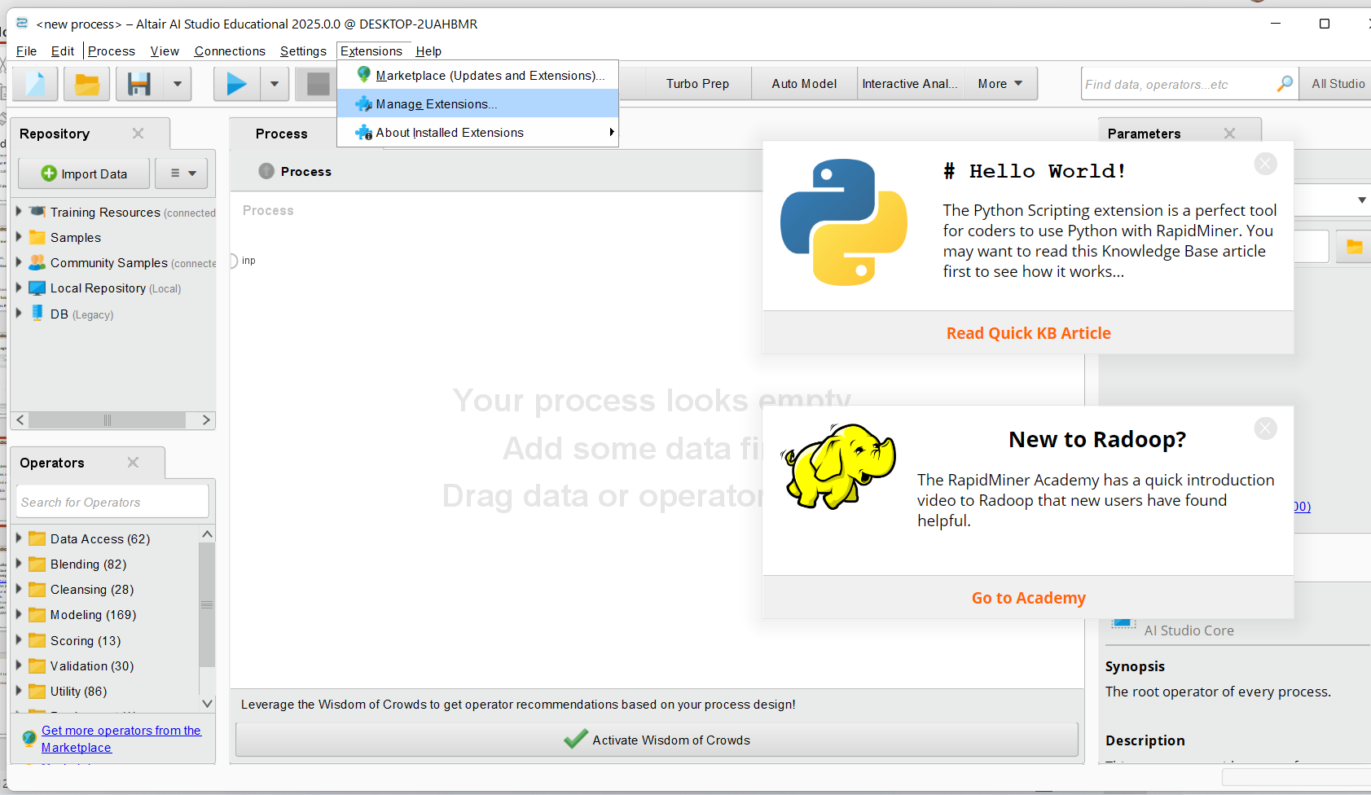
RapidMiner Studio - Extensions
3. Managing and Uninstalling Extensions
Go to Extensions > Manage Extensions to:
View installed extensions.
Enable/disable extensions.
Uninstall unnecessary extensions.

Slide 128
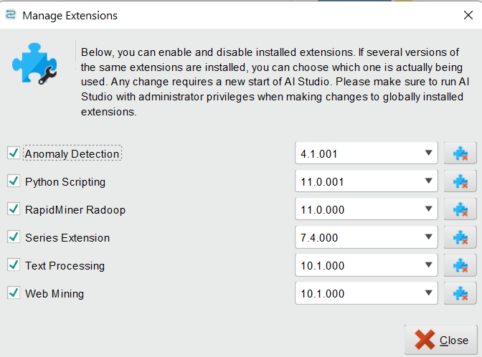
RapidMiner Studio - Extensions
3. Managing and Uninstalling Extensions
Go to Extensions > Manage Extensions to:
View installed extensions.
Enable/disable extensions.
Uninstall unnecessary extensions.

Slide 129
RapidMiner Studio - Extensions
4. Alternative Installation (Manual Method)
If the Marketplace is unavailable due to network restrictions (proxy/firewall):
Visit RapidMiner Marketplace.
Download the JAR file of the extension.
Place it in the extensions folder:
Windows: C:\Users\<username>\.RapidMiner\extensions\
Mac/Linux: ~/.RapidMiner/extensions/
Restart RapidMiner to activate the extension.

Slide 130
Extension
Does lecturer need to approve or process short extension requests? No, short extensions are automatically approved once students submit their requests via the appropriate system.
What if a student submits a short extension request after the original due date? Late extension requests are not accepted. Students must apply for special consideration https://www.studentportal.acu.edu.au/course/assessment-exams-and-results/special-consideration if they missed the original deadline.

Slide 131
Extension
Are group assignments eligible for short extensions?
No, group assignments and certain other tasks (e.g., exams, practical assessments) are not eligible for automatic extensions. You can include a statement in the assessment description to indicate that this assessment type is excluded from the automatic extension process.

Slide 132
Extension
What happens if a student misses the 72-hour extension deadline?
As per the Assessment Procedures, assessments submitted more than 72 hours after the extended due date will not be marked unless the student has been granted special consideration.

Slide 133
Extension
Students who require more than the 72-hour automatic extension can request additional time via email by attaching their EIP as evidence. Staff can adjust the due date and time for these students using the 'Assign-To’ Or https://community.canvaslms.com/t5/Instructor-Guide/How-do-I-assign-an-assignment-to-everyone-individual-students-or/ta-p/1191 button in Canvas.

Slide 134
Extension
How do I handle a situation where a student claims technical issues prevented them from submitting? Refer the student to the special consideration process for technical difficulties, as supporting evidence will be required.https://www.studentportal.acu.edu.au/course/assessment-exams-and-results/special-consideration

Slide 135
Thank You
Have a Great Learning Day!
Feel free to reach out with any questions!

